Slide 1

Cash Gamma Demo Model
Presented by:
Data Science (Pradeepa)
28th July 2025

Slide 2
Architecture Overview of TDB’s Risk Scorecards
For Cash Loan only
For both Cash and SIL
Limit Setting Model (Hosted in Digital Layer)
Credit Decisioning Model (Hosted in Taran)
Beta Stack
Alpha Stack
Trench 1: New Users - within 30 days from TSA Onboarding
Limit Setting Score = Gamma Stack
Beta Demo Score
Beta Demo Score
Gamma Demo Score
Apps Score
Selectively call Alpha
Apps Score
Apps Score
Credo Score
Users automatically move from Trench 1 to Trench 2 after 30 days if no disbursed loans
Credo Score
CIC Score
Gamma Income Model
Beta Income Model
Alpha Income Model
Users will stay in Trench 2 until 1st disbursed loan. His Gamma Stack will be re-calculated every 30-day anniversary from TSA onboarding date
Limit Setting Score = Gamma Stack
Beta Stack
Alpha Stack
Gamma Demo Score
Beta Demo Score
Beta Demo Score
Trench 2: Existing Users - After 30 days from TSA Onboarding AND Never Disbursed Loan
Selectively call Alpha
Apps Score
Apps Score
Apps Score
Transaction Score
Transaction Score
Transaction Score
CIC Score
Gamma Income Model
Beta Income Model
Alpha Income Model
Users will move to Trench 3 after 1st Disbursed Loan
Lowest Risk users from this B Score will be pre-approved for upsell and xsell. Medium Risk users from this B Score will have to go through Taran.
High Risk users from this B Score will not be given any offer.
B Score = Gamma Stack
Trench 3: Existing Users - After 30 days from 1st Disbursed Loan AND current DPD <= 10
Beta Stack
Alpha Stack
Gamma Demo Score
Apps Score
Beta Demo Score
Selectively call Alpha
Beta Demo Score
Apps Score
Apps Score
Enhanced Transaction Score
Enhanced Transaction Score
Once moved to Trench 3, user will forever remain in Trench 3. His Gamma Stack will be re-calculated every 30 days anniversary from 1st Loan Disbursement Date
Enhanced Transaction Score
CIC Score
Gamma Income Model
Beta Income Model
Alpha Income Model

Slide 3
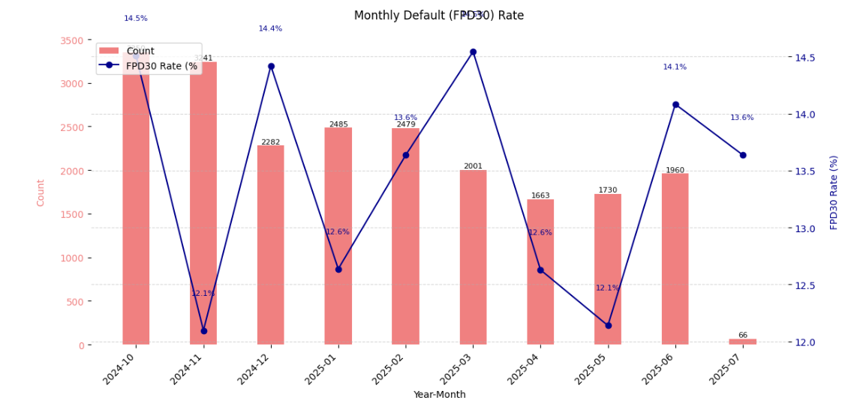
Cash Gamma Demo Model: Cash Gamma Demo Score was developed on Trench 1 (DOB <= 30 and without any disbursedloan) and Trench 2 (DOB > 30 and without any disbursed loan)
 | Loan Disbursement Date | # Count |  |  | # Bad (FPD30) Quick Loans |  |  | FPD30 rate
 |  | Overall | Trench 1 | Trench 2 | Overall | Trench 1 | Trench 2 | Overall | Trench 1 | Trench 2
Training (90%) | 01/10/2024 - 28/02/2025 | 12453 | 7631 | 4822 | 1669 | 974 | 695 | 0.134 | 0.1276 | 0.1441
Validation (10%) | 01/10/2024 -28/02/2025 | 1384 | 874 | 510 | 190 | 114 | 76 | 0.1373 | 0.1304 | 0.149
Test(Mar) | 01/03/2025 - 31/03/2025 | 2001 | 952 | 1049 | 291 | 126 | 165 | 0.1454 | 0.1324 | 0.1573
OOT (Apr) | 01/04/2025 - 31/04/2025 | 1663 | 815 | 848 | 210 | 95 | 115 | 0.1263 | 0.1166 | 0.1356
OOT(May) | 01/05/2025 - 22/05/2025 | 1730 | 919 | 811 | 210 | 107 | 103 | 0.1214 | 0.1164 | 0.127
OOT(Jun) | 01/06/2025 - 30/06/2025 | 1960 | 1081 | 879 | 276 | 141 | 135 | 0.1408 | 0.1304 | 0.1536
OOT(Jul) | 01/07/2025 - 09/07/2025 | 66 | 31 | 35 | 9 | 7 | 2 | 0.1364 | 0.2258 | 0.0571
3

Slide 4
Feature Selection Methodology Overview
Feature Selection Methodology Overview
34
Feats
25
Feats
22 Feats
22 Feats
12 Feats
IV > 0.01
Missing Rate < 95%
Inter-correlation < 75%
Individual Feature Evaluation

Slide 5
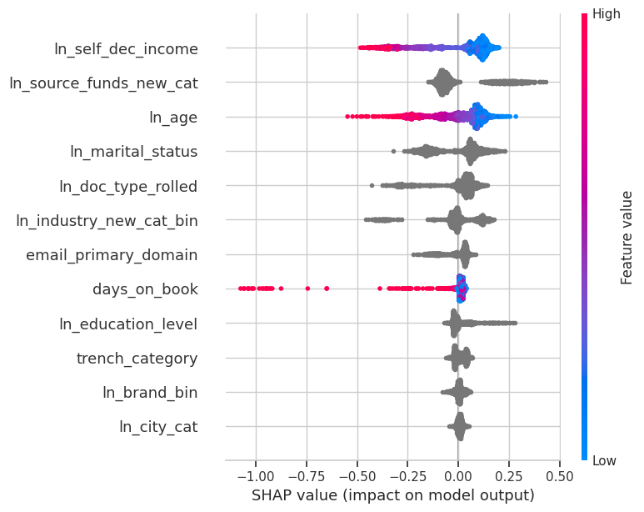
SHAP ( 12 feat )
The horizontal axis shows how much a feature affects the prediction. Points to the right mean the feature increases the prediction, and points to the left mean it decreases it.
The color of each dot shows the feature value: red means the value is high, and blue means the value is low.
If red dots are mostly on the right, it means high values of that feature increase the prediction. If red dots are on the left, high values decrease the prediction.
The features are listed on the vertical axis, from most important at the top to least important at the bottom.

Slide 6
Feature Description
Feature Name | Feature Description
ln_self_dec_income | Self declared income of customer.
ln_source_funds_new_cat | Different sources of a person’s income.
ln_age | Age of the loan applicant
ln_marital_status | Marital status of the loan applicant.
ln_doc_type_rolled | Type of identification document provided by the loan applicant.
ln_industry_new_cat_bin | Type of industry in which loan applicant is employed.
email_primary_domain | Domain from the primary email address of the user.
days_on_book | Difference between loan application submission date and onboarding date
ln_education_level | Highest Education Level of loan applicant.
trench_category | Trench 1 if applied within 30 days of onboarding, otherwise as Trench 2.
ln_brand_bin | Brand of mobile
ln_city_cat | Applicant's declared city of residence during the loan application.

Slide 7
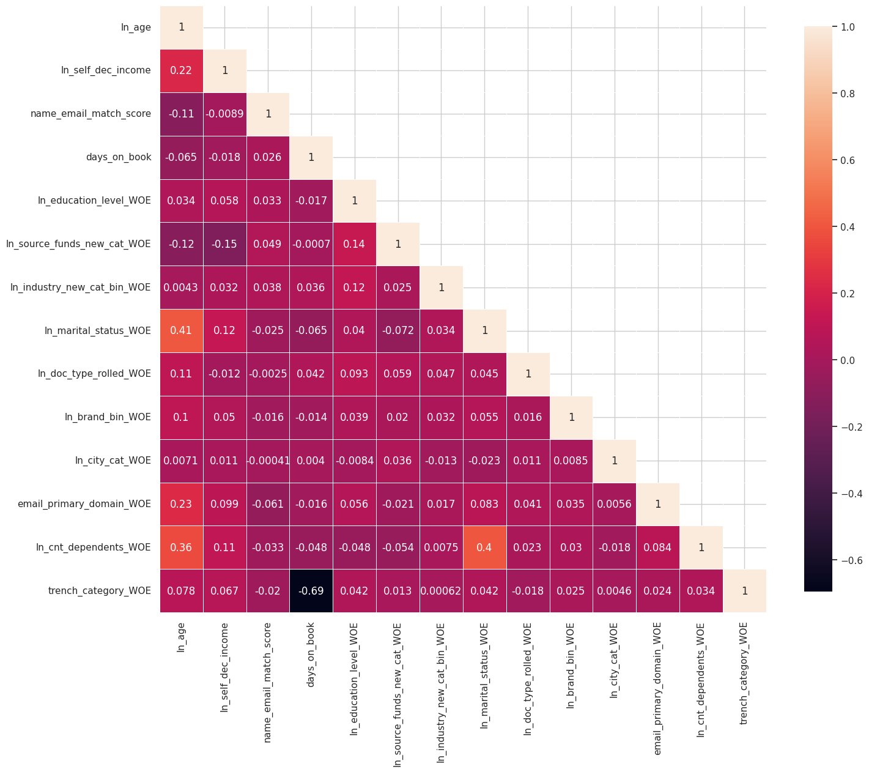
Inter-Correlation ( 12 feat )
From the correlation plot, we can see that the highest correlation is between trench_category_WOE and days_on_book, at 69%, followed by ln_marital_status_WOE and ln_age at 41%.
These are the maximum correlations observed, and no other feature pairs show particularly high values.
The numbers in the plot indicate how strongly two features are related — values close to 1 suggest a strong positive correlation (both features increase together),
while values close to -1 imply a strong negative correlation (one increases while the other decreases).

Slide 8
Iteration | Feature | Train Gini (2024-10-01 - 2025-02-28) | Val Gini | Mar Test Gini | Apr Gini | May Gini (2025-05-22)
Model with top 1 feat | ln_self_dec_income_WOE | 0.0944 | 0.1134 | 0.1086 | 0.0870 | 0.0702
Model with top 2 feat | ln_source_funds_new_cat_WOE | 0.1454 | 0.1933 | 0.1881 | 0.1157 | 0.1688
Model with top 3 feat | ln_age_WOE | 0.1849 | 0.2099 | 0.1836 | 0.1337 | 0.2008
Model with top 4 feat | ln_marital_status_WOE | 0.1969 | 0.1933 | 0.1893 | 0.1084 | 0.1722
Model with top 5 feat | ln_doc_type_rolled_WOE | 0.2105 | 0.2152 | 0.2041 | 0.1360 | 0.1529
Model with top 6 feat | ln_industry_new_cat_bin_WOE | 0.2268 | 0.2204 | 0.2338 | 0.1484 | 0.1730
Model with top 7 feat | email_primary_domain_WOE | 0.2292 | 0.2226 | 0.2285 | 0.1480 | 0.1757
Model with top 8 feat | days_on_book_WOE | 0.2332 | 0.2469 | 0.2369 | 0.1599 | 0.1833
Model with top 9 feat | ln_education_level_WOE | 0.2383 | 0.2391 | 0.2616 | 0.1694 | 0.2136
Model with top 10 feat | trench_category_WOE | 0.2382 | 0.2392 | 0.2619 | 0.1697 | 0.2134
Model with top 11 feat | ln_brand_bin_WOE | 0.2401 | 0.2345 | 0.2613 | 0.1853 | 0.2156
Model with top 12 feat | ln_city_cat_WOE | 0.2447 | 0.2380 | 0.2561 | 0.1981 | 0.2180
12 feature model after Hyper Parameters Tuning | Trench 1 + Trench 2 | 0.2457 | 0.2401 | 0.2581 | 0.1986 | 0.2178
 | Trench 1 | 0.2400 | 0.1985 | 0.2128 | 0.2316 | 0.2876
 | Trench 2 | 0.2469 | 0.2508 | 0.2868 | 0.1588 | 0.1431
Hyperparameter | Value
C | 0.000380
Ln_ratio | 1.0
Solver | liblinear
ipenalty | L2
Max_iter | 571
random_seed | 42
Hyperparameter values for the best model chosen after the HP Tuning using Optuna
8

Slide 9
SHAP Ranks are very consistent Across Training, Test and OOT Windows
Feature | Train Gini (Oct'2024-Feb'25) | Mar Test Gini | Apr Gini | May Gini May'25
ln_self_dec_income | 1 | 1 | 1 | 1
ln_source_funds_new_cat | 2 | 2 | 2 | 2
ln_marital_status | 3 | 3 | 3 | 3
ln_age | 4 | 4 | 4 | 4
ln_industry_new_cat_bin | 5 | 6 | 5 | 5
ln_doc_type_rolled | 6 | 5 | 6 | 6
email_primary_domain | 7 | 7 | 7 | 7
ln_education_level | 8 | 8 | 9 | 8
days_on_book | 9 | 9 | 8 | 9
trench_category | 10 | 10 | 10 | 10
ln_brand_bin | 11 | 11 | 11 | 11
ln_city_cat | 12 | 12 | 12 | 12
9

Slide 10
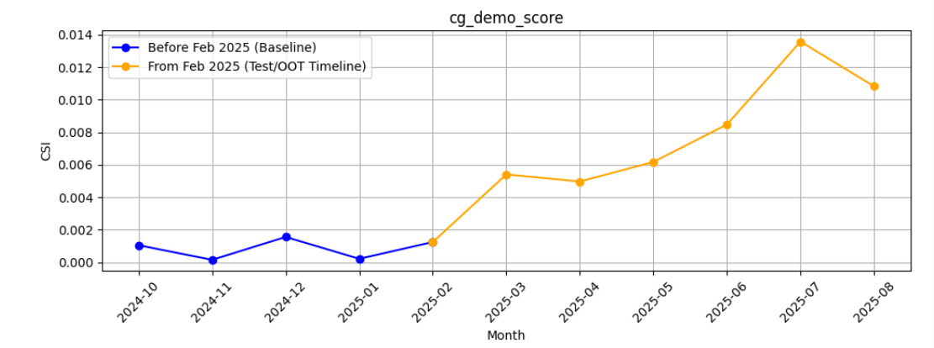
M-O-M Model PSI values (Baseline Training period) - Overall Applied
10

Slide 11
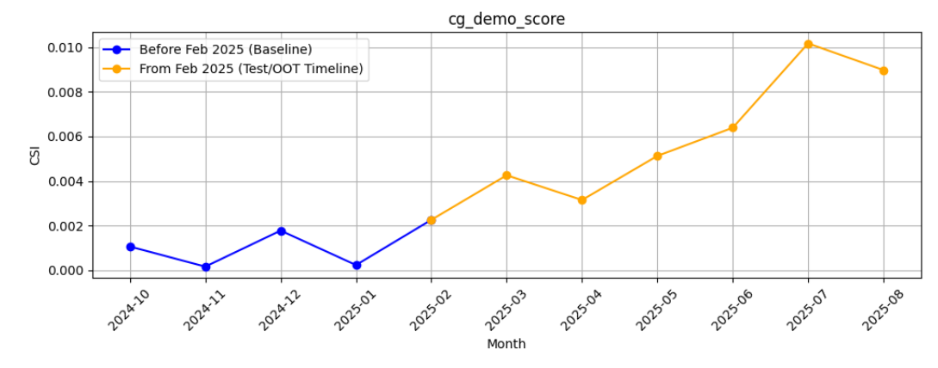
M-O-M Model PSI values (Baseline Training period) - Android Applied
11

Slide 12
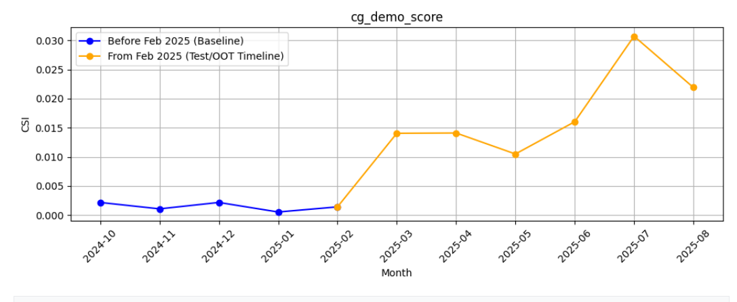
M-O-M Model PSI values (Baseline Training period) - iOS Applied
12

Slide 13
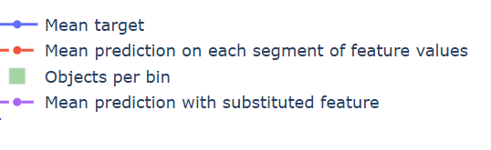
Feature Stability Plot Legend Table
Symbol / Line | Name | What It Shows | How to Interpret
🔷 Blue Line | Mean Target | Average true target (e.g., default rate) in each bin of the feature | 📈 Spiky → Target is unstable or noisy 📉 Smooth → Target changes consistently
🔴 Red Dashed Line | Mean Prediction | Model's average predicted score in each bin | Should generally follow blue line Slightly smoother → Model generalizes to avoid overfitting
🟩 Green Bars | Objects per Bin | Count of data points in each bin | High = reliable signal ⚠️ Very low = sparse data = risk of overfitting or unreliable predictions
🟣 Purple Dotted Line | Mean Prediction with Substituted Feature | Prediction if this feature was shuffled or replaced randomly | Closer to red = model doesn’t rely much on feature Further from red = model depends heavily on feature
13

Slide 14
Feature Evaluation Plots (12 features)

Slide 15
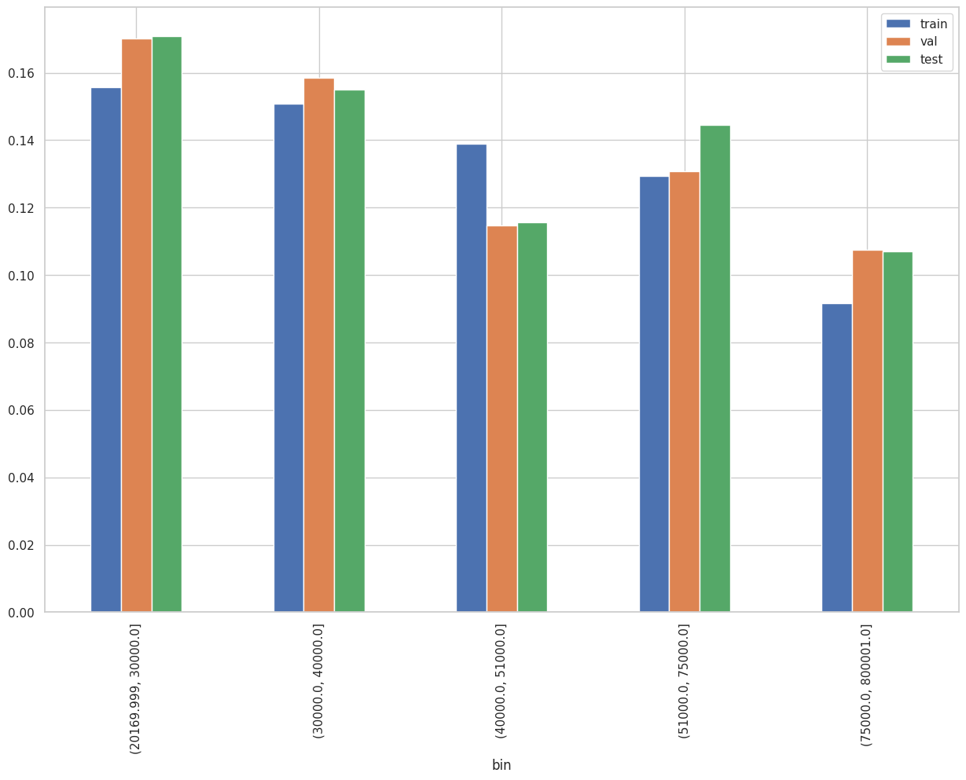
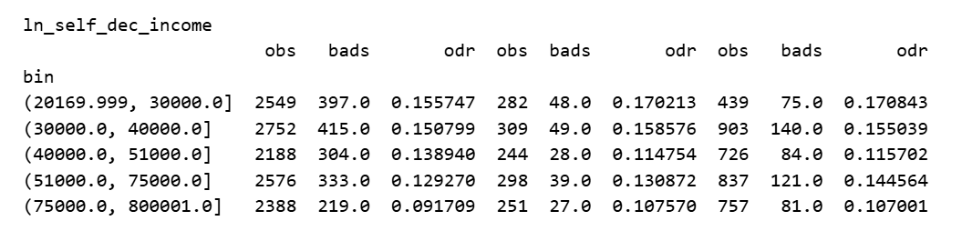
Rank# 1: ln_self_dec_income ( 1 / 6 ) - Feature Performance in Train vs Test <Disbursed>
Self declared income of customer.
Please note these are just WOE Bins, NOT the final Bins that Catboost chooses internally

Slide 16
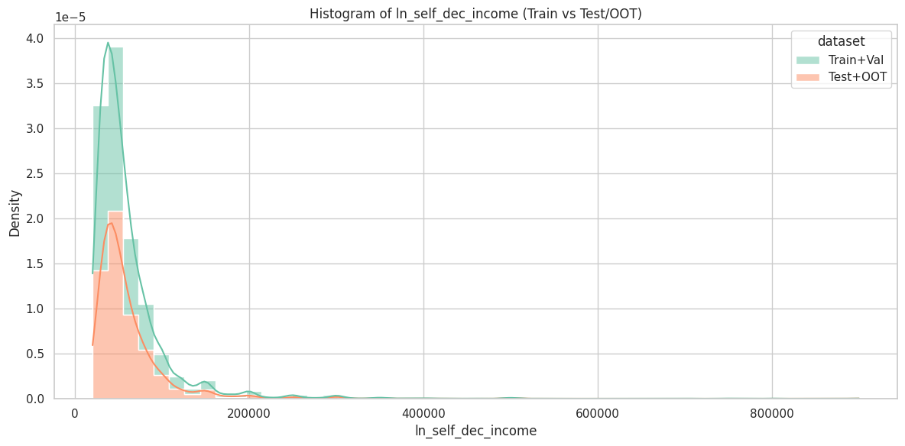
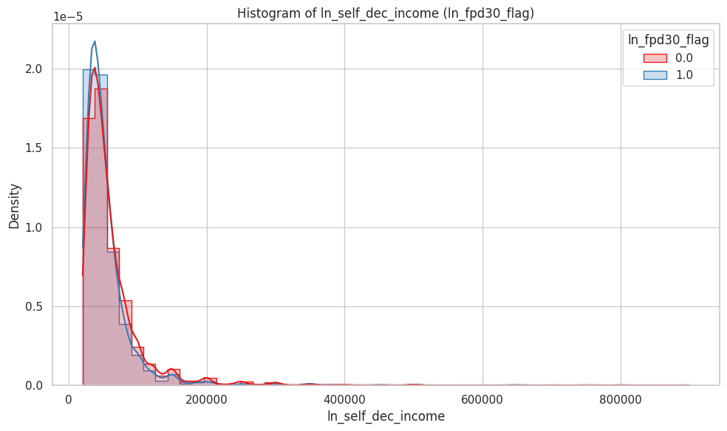
Rank# 1: ln_self_dec_income ( 2 / 6 ) - Histogram <Disbursed>
Most customers, whether good or bad, have low to moderate self-declared incomes. However, as income increases, the number of bad customers (blue line) becomes noticeably fewer. This suggests that customers who report higher incomes are less likely to be bad.
Both datasets (Train+Val and Test+OOT) show a similar income distribution, with most customers concentrated in the low-income range. The Test+OOT set (orange) has slightly fewer high-income records but overall follows the same trend as the Train+Val set (green), indicating good consistency across datasets.

Slide 17
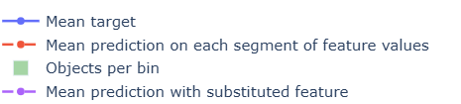
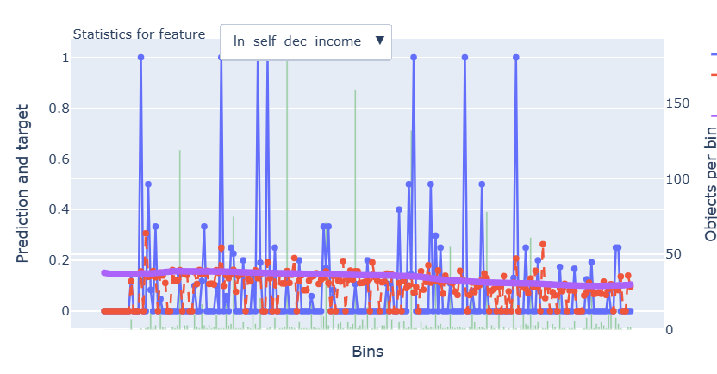
Rank# 1: ln_self_dec_income ( 3 / 6 ) - Feature Statistics Analysis <Disbursed>
The red line mostly follows the same trend as the blue line, showing the model is using this feature effectively.
The red and purple lines consistently show a positive gap, which means this feature helps make predictions more accurate and closer to the actual target.
The green bars (data per bin) show good distribution across income levels, though some bins have fewer samples.
The target rate shows a general downward trend with higher income, making this a useful feature for the model.

Slide 18
Rank# 1: ln_self_dec_income ( 4 / 6 ) - MoM Mean Distribution <Applied>
month | Applied Count | Approval Rate | ln_self_dec_income | ​ | Avg. Demo Score
2024-10 | 50274 | 7.8% | 30489.11 | ​ | 0.309692
2024-11 | 45303 | 8.2% | 32111.11 | ​ | 0.308101
2024-12 | 37220 | 8.3% | 34404.49 | ​ | 0.30731
2025-01 | 40533 | 8.2% | 33453.39 | ​ | 0.307182
2025-02 | 42856 | 7.6% | 32903.56 | ​ | 0.30672
2025-03 | 35771 | 7.9% | 33451.53 | ​ | 0.309106
2025-04 | 35833 | 7.1% | 33121.31 | ​ | 0.308743
2025-05 | 34088 | 7.8% | 34205.74 | ​ | 0.309369
2025-06 | 41972 | 7.6% | 33663.12 | ​ | 0.309559
2025-07 | 42360 | 7.1% | 33209.63 | ​ | 0.309787
2025-08 | 39725 | 7.5% | 32744.44 |  | 0.312698
The feature rises from ~30,500 in Oct 2024 to ~34,200 in May 2025, showing a steady and positive upward trend. From June 2025, the income stabilizes around ~32,700–33,700, consistently staying within the range of ~32,700–34,200 after Dec 2024.
It shows strong stability with only minor fluctuations, making it highly reliable for modeling and giving confidence in its consistent predictions.

Slide 19
Rank# 1: ln_self_dec_income ( 5 / 6 ) - MoM Mean Distribution <Applied> < Trench wise>
Trench 1
month | Applied Count | Approval Rate | ln_self_dec_income | ​ | Avg. Demo Score
2024-10 | 39190 | 5.3% | 29339.96 |  | 0.314699
2024-11 | 34274 | 5.8% | 31016.83 |  | 0.31391
2024-12 | 25820 | 6.0% | 33381.16 |  | 0.313247
2025-01 | 27778 | 5.9% | 32101.29 |  | 0.311792
2025-02 | 28786 | 5.1% | 31311.48 |  | 0.309977
2025-03 | 20948 | 4.5% | 31298.71 |  | 0.311041
2025-04 | 21705 | 3.8% | 30901.53 |  | 0.310846
2025-05 | 21323 | 4.4% | 32090.99 |  | 0.312189
2025-06 | 25432 | 4.7% | 31722.7 |  | 0.313444
2025-07 | 25752 | 4.5% | 31258.84 |  | 0.313286
2025-08 | 26280 | 4.3% | 31067.11 |  | 0.316449
Trench 2
month | Applied Count | Approval Rate | ln_self_dec_income | ​ | Avg. Demo Score
2024-10 | 11084 | 16.6% | 34552.19 |  | 0.30525
2024-11 | 11029 | 15.7% | 35511.73 |  | 0.303022
2024-12 | 11400 | 13.5% | 36722.25 |  | 0.301458
2025-01 | 12755 | 13.4% | 36398.02 |  | 0.302407
2025-02 | 14070 | 12.5% | 36160.81 |  | 0.302822
2025-03 | 14823 | 12.7% | 36493.93 |  | 0.30533
2025-04 | 14128 | 12.0% | 36531.58 |  | 0.304453
2025-05 | 12765 | 13.6% | 37738.27 |  | 0.304167
2025-06 | 16540 | 12.0% | 36646.71 |  | 0.30317
2025-07 | 16608 | 11.2% | 36234.48 |  | 0.304117
2025-08 | 13445 | 13.7% | 36023.01 |  | 0.306625
Self-declared income remains stable, ranging from ~29,300 to ~33,400, showing no sharp fluctuations.
Minor peaks in Dec’24 and May’25 indicate slight variations, but overall the feature is consistent and reliable for modeling.
Self-declared income shows a steady upward trend, ranging from ~34,550 to ~37,740, reflecting gradual growth over time.
Minor fluctuations in certain months (e.g., Jan’25 and Jul’25) are observed, but overall the feature remains stable and reliable for modeling.

Slide 20
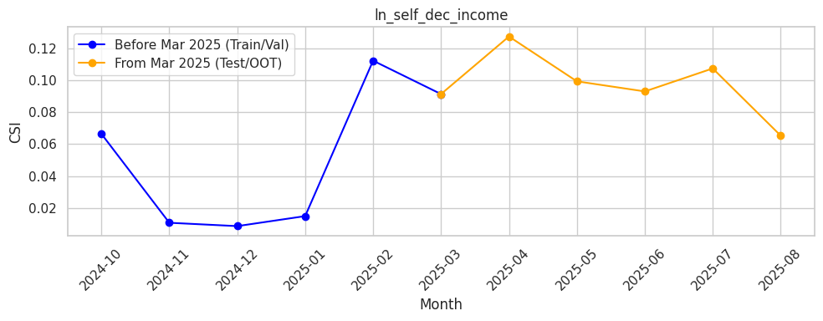
Rank# 1: ln_self_dec_income ( 6 / 6 ) - Feature CSI Analysis <Applied>
During the baseline period (Oct 2024 to Feb 2025), CSI fluctuated between 0.009 in December and 0.112 in February, showing some variation but staying within acceptable levels.
In the Test/OOT period (Mar to Aug 2025), CSI peaked at 0.127 in April and remained mostly around 0.09–0.10 in later months.Overall, the values stayed close to the 0.1 threshold, indicating the feature is largely stable with only mild fluctuations.

Slide 21
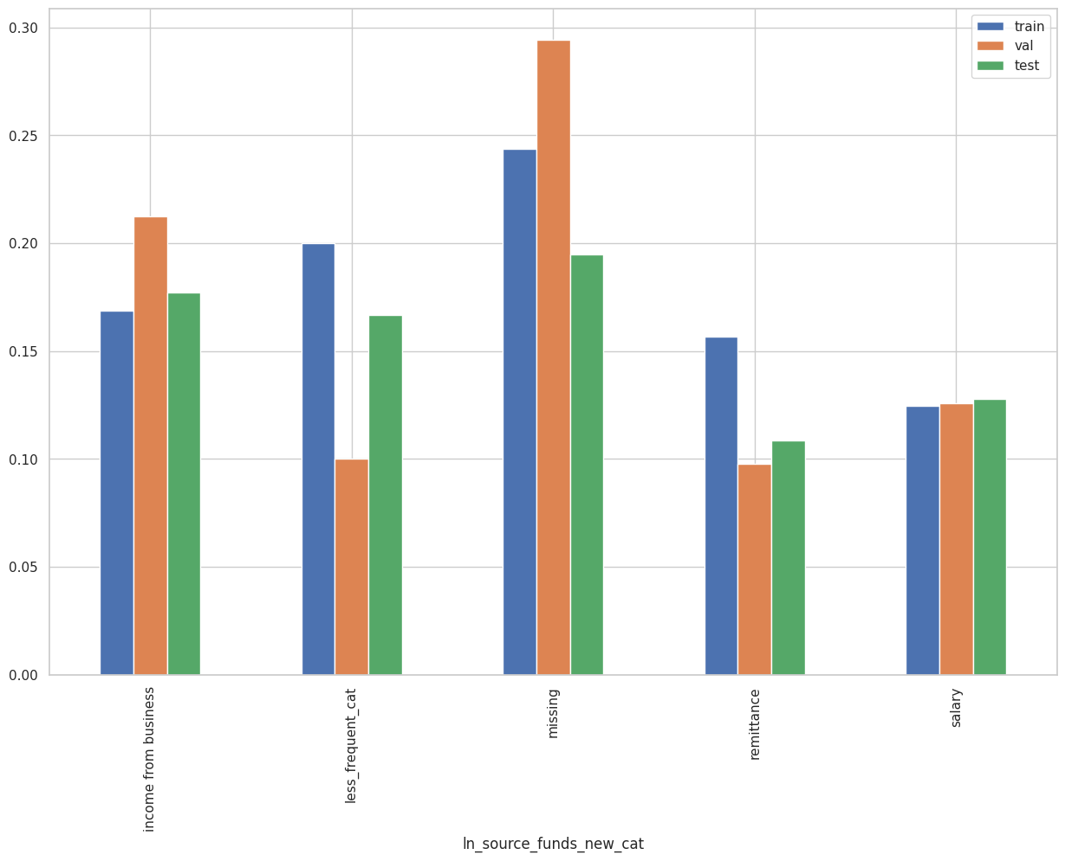
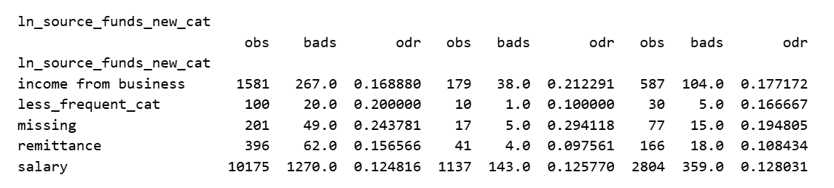
Rank# 2: ln_source_funds_new_bin ( 1 / 5 ) - Feature Performance in Train vs Test <Disbursed>
It represents different sources of a person’s income.
Less_Frequency_Cat
Allowance ,Pension, Interest on deposits and investments, Inheritance/retirement funds

Slide 22
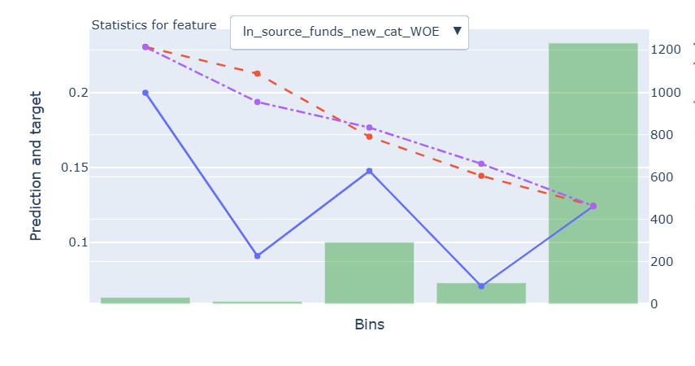
Rank# 2: ln_source_funds_new_bin ( 2 / 5 ) - Feature Statistics Analysis <Disbursed>
The red line closely follows the trend of the blue line , indicating the model is effectively leveraging the feature.
A clear gap between the red and purple lines shows that the feature helps improve prediction accuracy.
The green bars highlight good distribution, although some bins have fewer records, with the majority concentrated in the last bin.
The target rate decreases across the bins, which matches the WOE transformation and shows that the feature is important for the model.

Slide 23
Rank# 2: ln_source_funds_new_bin ( 3 / 5 ) - MoM Feature Distribution <Applied>
month | Applied Count | Approval Rate | salary | income from business | less_frequent_cat | remittance | missing | ​ | Avg. Demo Score
2024-10 | 50274 | 7.8% | 72.62% | 12.97% | 5.33% | 4.21% | 4.86% | ​ | 0.309692
2024-11 | 45303 | 8.2% | 73.03% | 13.09% | 5.32% | 4.00% | 4.56% | ​ | 0.308101
2024-12 | 37220 | 8.3% | 72.51% | 13.69% | 5.06% | 4.49% | 4.25% | ​ | 0.30731
2025-01 | 40533 | 8.2% | 73.64% | 12.83% | 5.05% | 4.35% | 4.13% | ​ | 0.307182
2025-02 | 42856 | 7.6% | 73.20% | 12.99% | 5.30% | 4.32% | 4.19% | ​ | 0.30672
2025-03 | 35771 | 7.9% | 73.19% | 13.05% | 5.45% | 4.24% | 4.06% | ​ | 0.309106
2025-04 | 35833 | 7.1% | 74.44% | 13.93% | 4.86% | 4.43% | 2.34% | ​ | 0.308743
2025-05 | 34088 | 7.8% | 76.52% | 14.85% | 3.91% | 4.73% | 0.00% | ​ | 0.309369
2025-06 | 41972 | 7.6% | 74.54% | 15.09% | 5.84% | 4.48% | 0.04% | ​ | 0.309559
2025-07 | 42360 | 7.1% | 72.39% | 15.36% | 7.74% | 4.41% | 0.09% | ​ | 0.309787
2025-08 | 39725 | 7.5% | 72.27% | 15.09% | 8.09% | 4.54% | 0.01% |  | 0.312698
Salary remains the dominant source, consistently ~72%–77%, showing stable reliance.
Income from business rises from ~13% in Oct 2024 to ~15% in Jul–Aug 2025, reflecting growing diversity in income sources.
Less frequent categories fluctuate ~4%–8%, while remittance stays ~4%–5%.
Missing data drops from ~4.8% in Oct 2024 to near 0% by May 2025, highlighting improved data quality and reliability.

Slide 24
Rank# 2: ln_source_funds_new_bin ( 4 / 5 ) - MoM Feature Distribution <Applied> < Trench Wise>
Trench 1
month | Applied Count | Approval Rate | salary | income from business | less_frequent_cat | remittance | missing | ​ | Avg. Demo Score
2024-10 | 39190 | 5.3% | 72.12% | 13.35% | 5.37% | 3.91% | 5.25% |  | 0.314699
2024-11 | 34274 | 5.8% | 72.91% | 13.39% | 5.36% | 3.63% | 4.72% |  | 0.31391
2024-12 | 25820 | 6.0% | 71.03% | 14.61% | 5.37% | 4.26% | 4.73% |  | 0.313247
2025-01 | 27778 | 5.9% | 72.45% | 13.47% | 5.33% | 4.06% | 4.70% |  | 0.311792
2025-02 | 28786 | 5.1% | 71.67% | 13.66% | 5.78% | 4.05% | 4.84% |  | 0.309977
2025-03 | 20948 | 4.5% | 71.34% | 14.01% | 6.10% | 3.86% | 4.70% |  | 0.311041
2025-04 | 21705 | 3.8% | 72.35% | 15.14% | 5.57% | 4.28% | 2.66% |  | 0.310846
2025-05 | 21323 | 4.4% | 74.44% | 16.14% | 4.78% | 4.64% | 0.00% |  | 0.312189
2025-06 | 25432 | 4.7% | 71.76% | 16.04% | 7.62% | 4.57% | 0.01% |  | 0.313444
2025-07 | 25752 | 4.5% | 69.37% | 16.29% | 9.91% | 4.42% | 0.01% |  | 0.313286
2025-08 | 26280 | 4.3% | 69.70% | 15.84% | 10.14% | 4.32% | 0.00% |  | 0.316449
Salary continues to dominate in Trench 1, consistently around 69–74%, showing stable reliance on salaried income.
Income from business gradually rises from 13% to 16%, reflecting a steady increase in entrepreneurial income.
Missing data reduces to nearly 0%, demonstrating improved data quality and consistency for Trench 1.
Trench 2
month | Applied Count | Approval Rate | salary | income from business | remittance | less_frequent_cat | missing | ​ | Avg. Demo Score
2024-10 | 11084 | 16.6% | 74.41% | 11.65% | 5.28% | 5.18% | 3.48% |  | 0.30525
2024-11 | 11029 | 15.7% | 73.41% | 12.17% | 5.17% | 5.20% | 4.05% |  | 0.303022
2024-12 | 11400 | 13.5% | 75.86% | 11.61% | 5.02% | 4.36% | 3.16% |  | 0.301458
2025-01 | 12755 | 13.4% | 76.23% | 11.43% | 4.99% | 4.45% | 2.89% |  | 0.302407
2025-02 | 14070 | 12.5% | 76.34% | 11.61% | 4.88% | 4.31% | 2.86% |  | 0.302822
2025-03 | 14823 | 12.7% | 75.81% | 11.70% | 4.78% | 4.54% | 3.17% |  | 0.30533
2025-04 | 14128 | 12.0% | 77.65% | 12.08% | 4.68% | 3.75% | 1.85% |  | 0.304453
2025-05 | 12765 | 13.6% | 79.99% | 12.69% | 4.86% | 2.45% | 0.00% |  | 0.304167
2025-06 | 16540 | 12.0% | 78.82% | 13.63% | 4.35% | 3.11% | 0.09% |  | 0.30317
2025-07 | 16608 | 11.2% | 77.08% | 13.92% | 4.40% | 4.38% | 0.22% |  | 0.304117
2025-08 | 13445 | 13.7% | 77.29% | 13.63% | 4.96% | 4.09% | 0.02% |  | 0.306625
Salary remains the dominant source in Trench 2, consistently around 74–80%, showing strong stability and reliance on salaried income.
Income from business gradually rises from ~11.6% to ~13.9%, reflecting a modest but steady increase in entrepreneurial income.
Missing data reduces to almost 0%, indicating improved data quality and reporting consistency for Trench 2.

Slide 25
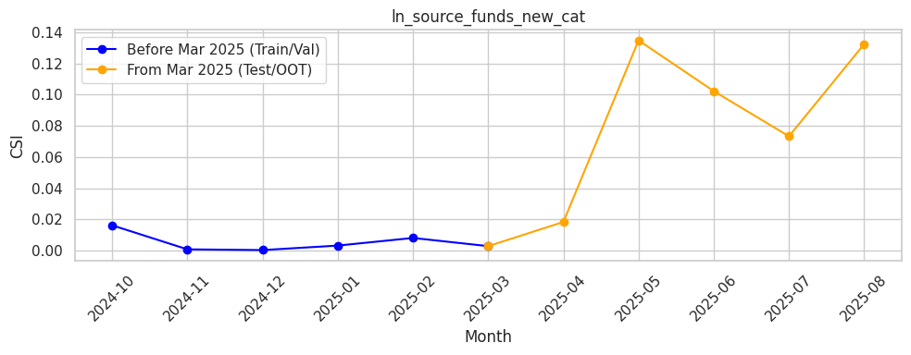
Rank# 2: ln_source_funds_new_bin ( 5 / 5 ) - Feature CSI Analysis <Applied>
During the baseline period (Oct 2024 to Feb 2025), CSI remained very low and stable, staying close to zero with minimal variation.
In the Test/OOT period (Mar to Aug 2025), CSI showed an increase, peaking at 0.135 in May and 0.132 in August.Although the values crossed the 0.1 threshold at times, the overall trend indicates moderate fluctuations that should be monitored for stability.

Slide 26
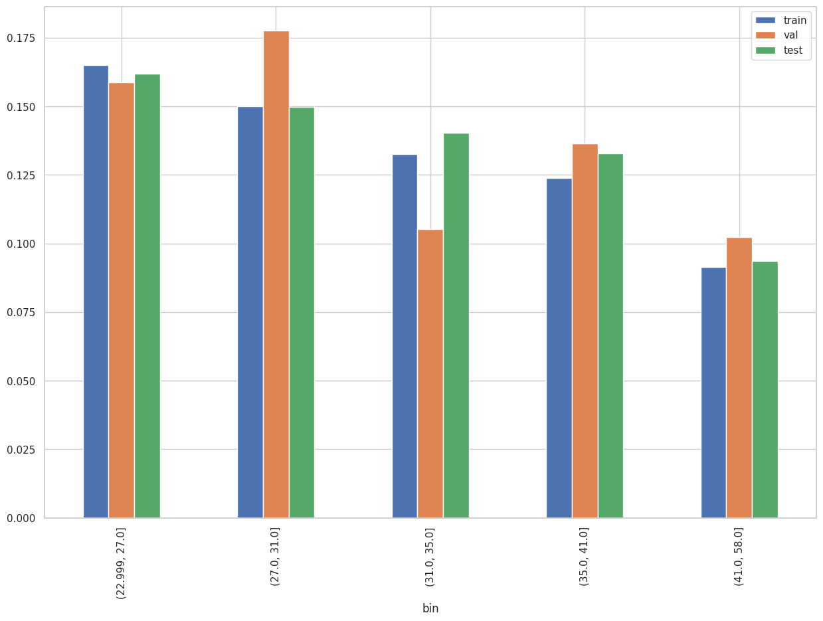
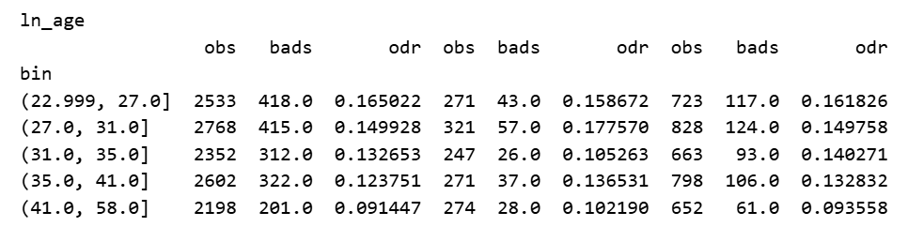
Rank# 3: ln_age ( 1 / 6 ) - Feature Performance in Train vs Test <Disbursed>
Age of the loan applicant/customer
26
Please note these are just WOE Bins, NOT the final Bins that Catboost chooses internally

Slide 27
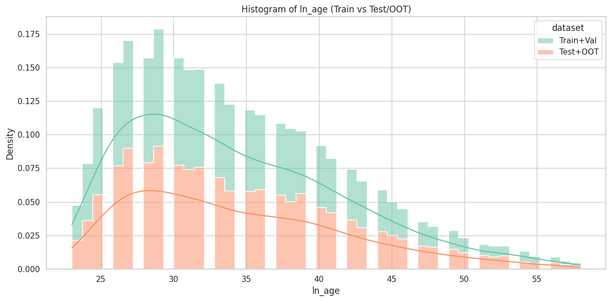
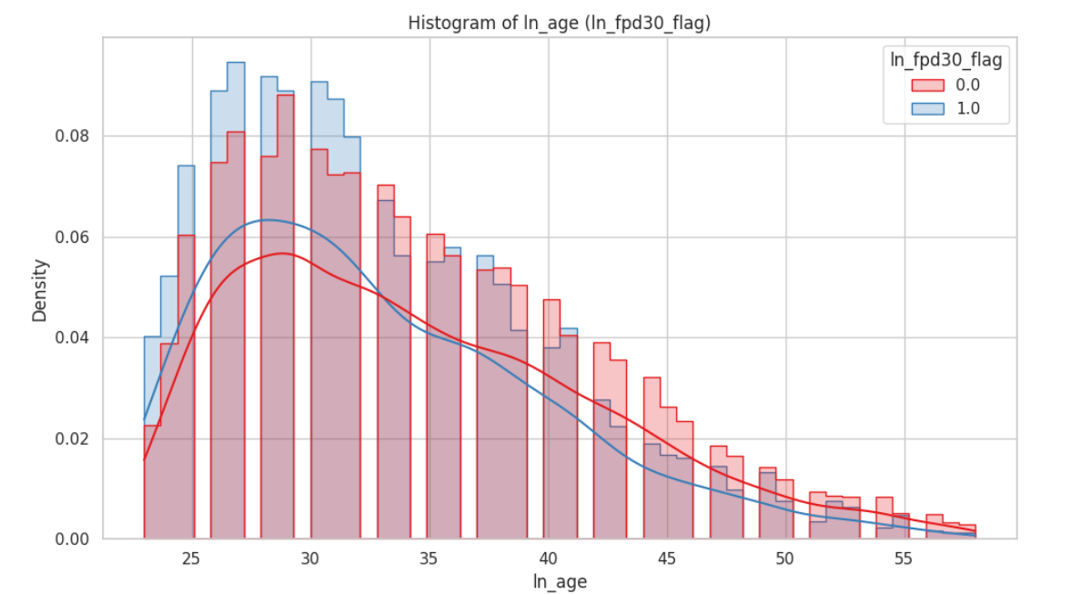
Rank# 3: ln_age ( 2 / 6 ) - Histogram <Disbursed>
Most customers, both good and bad, are in their late 20s to early 30s, with similar overall age distributions. However, bad customers (blue line) tend to be slightly younger on average, while good customers (red line) are more common in older age groups.
The Train+Validation set (green) has a higher concentration of younger customers, especially around the late 20s to early 30s. The Test+OOT set (orange) follows a similar pattern but with lower density across all ages, indicating fewer samples and slightly older age distribution.

Slide 28
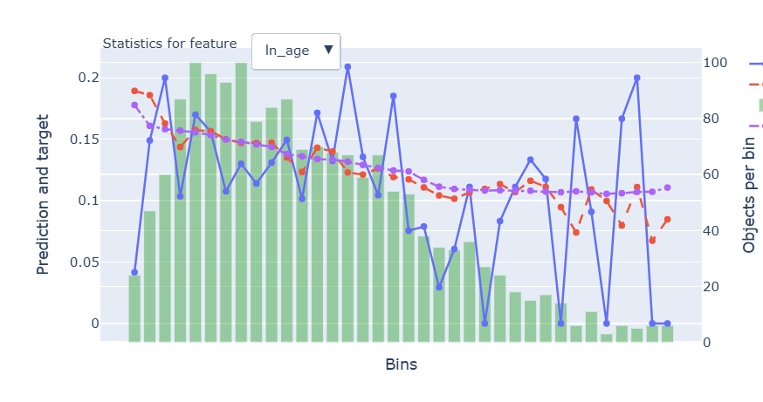
Rank# 3: ln_age ( 3 / 6 ) - Feature Statistics Analysis <Disbursed>
The red line closely follows the blue line, showing that the feature is well-aligned and works effectively.
The gap between the red and purple lines shows that the feature plays a key role in improving prediction accuracy.
The green bars (data per bin) show a well-distributed dataset, which helps maintain strong model performance across most bins.
The target rate decreases consistently across bins, highlighting the feature's effectiveness in the model.

Slide 29
Rank# 3: ln_age ( 4 / 6 ) - MoM Mean Distribution <Applied>
month | Applied Count | Approval Rate | ln_age | ​ | Avg. Demo Score
2024-10 | 50274 | 7.8% | 31.58 | ​ | 0.309692
2024-11 | 45303 | 8.2% | 31.64 | ​ | 0.308101
2024-12 | 37220 | 8.3% | 32.24 | ​ | 0.30731
2025-01 | 40533 | 8.2% | 31.63 | ​ | 0.307182
2025-02 | 42856 | 7.6% | 31.46 | ​ | 0.30672
2025-03 | 35771 | 7.9% | 31.26 | ​ | 0.309106
2025-04 | 35833 | 7.1% | 31.31 | ​ | 0.308743
2025-05 | 34088 | 7.8% | 31.38 | ​ | 0.309369
2025-06 | 41972 | 7.6% | 31.38 | ​ | 0.309559
2025-07 | 42360 | 7.1% | 31.26 | ​ | 0.309787
2025-08 | 39725 | 7.5% | 31.14 |  | 0.312698
The mean age starts at 31.58 in Oct 2024 and shows minor fluctuations, peaking at 32.24 in Dec 2024.
From Jan 2025 onward, the age stabilizes around 31.38, remaining within a consistent range of 31.14–31.38.
The feature exhibits strong stability with very minor fluctuations, making it reliable for modeling and predictive over time, with no abrupt changes observed.
29

Slide 30
Rank# 3: ln_age ( 5 / 6 ) - MoM Mean Distribution <Applied> <Trench wise>
Trench 1
month | Applied Count | Approval Rate | ln_age | ​ | Avg. Demo Score
2024-10 | 39190 | 5.3% | 31.38 |  | 0.314699
2024-11 | 34274 | 5.8% | 31.5 |  | 0.31391
2024-12 | 25820 | 6.0% | 32.25 |  | 0.313247
2025-01 | 27778 | 5.9% | 31.28 |  | 0.311792
2025-02 | 28786 | 5.1% | 30.96 |  | 0.309977
2025-03 | 20948 | 4.5% | 30.42 |  | 0.311041
2025-04 | 21705 | 3.8% | 30.59 |  | 0.310846
2025-05 | 21323 | 4.4% | 30.63 |  | 0.312189
2025-06 | 25432 | 4.7% | 30.71 |  | 0.313444
2025-07 | 25752 | 4.5% | 30.45 |  | 0.313286
2025-08 | 26280 | 4.3% | 30.39 |  | 0.316449
Trench 2
month | Applied Count | Approval Rate | ln_age | ​ | Avg. Demo Score
2024-10 | 11084 | 16.6% | 32.29 |  | 0.30525
2024-11 | 11029 | 15.7% | 32.08 |  | 0.303022
2024-12 | 11400 | 13.5% | 32.21 |  | 0.301458
2025-01 | 12755 | 13.4% | 32.41 |  | 0.302407
2025-02 | 14070 | 12.5% | 32.48 |  | 0.302822
2025-03 | 14823 | 12.7% | 32.43 |  | 0.30533
2025-04 | 14128 | 12.0% | 32.42 |  | 0.304453
2025-05 | 12765 | 13.6% | 32.62 |  | 0.304167
2025-06 | 16540 | 12.0% | 32.41 |  | 0.30317
2025-07 | 16608 | 11.2% | 32.52 |  | 0.304117
2025-08 | 13445 | 13.7% | 32.61 |  | 0.306625
Trench 1 age remains stable, ranging 30.39–32.25, with a slight peak in Dec 2024.
Values stabilize around 30.4–30.7 from Feb 2025 onward, showing consistent distribution.
Overall, the feature is reliable and predictive for modeling.
Trench 2 age is stable, ranging 32.08–32.62, with a slight increase over time.
Values remain around 32.4–32.6 from Jan 2025 onward, showing consistency.
The feature is reliable and steady, suitable for modeling.
30

Slide 31
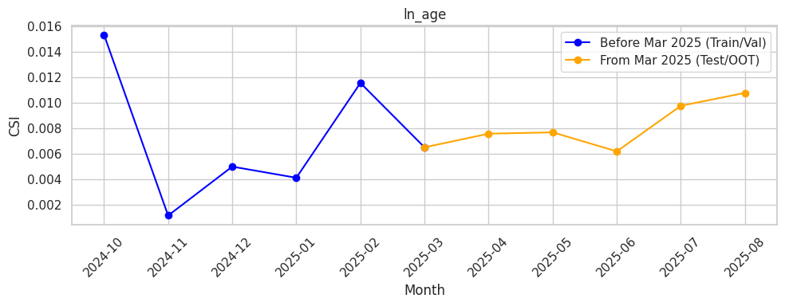
Rank# 3: ln_age ( 6 / 6 ) - Feature CSI Analysis <Applied>
During the baseline period (Oct 2024 to Feb 2025), CSI values were consistently low, ranging between 0.001 and 0.015, showing stable behavior.
In the Test/OOT period (Mar to Aug 2025), CSI remained steady with a slight upward trend, peaking at 0.011 in August.All values stayed well below the 0.1 threshold, confirming the feature remained highly stable and reliable over time.

Slide 32
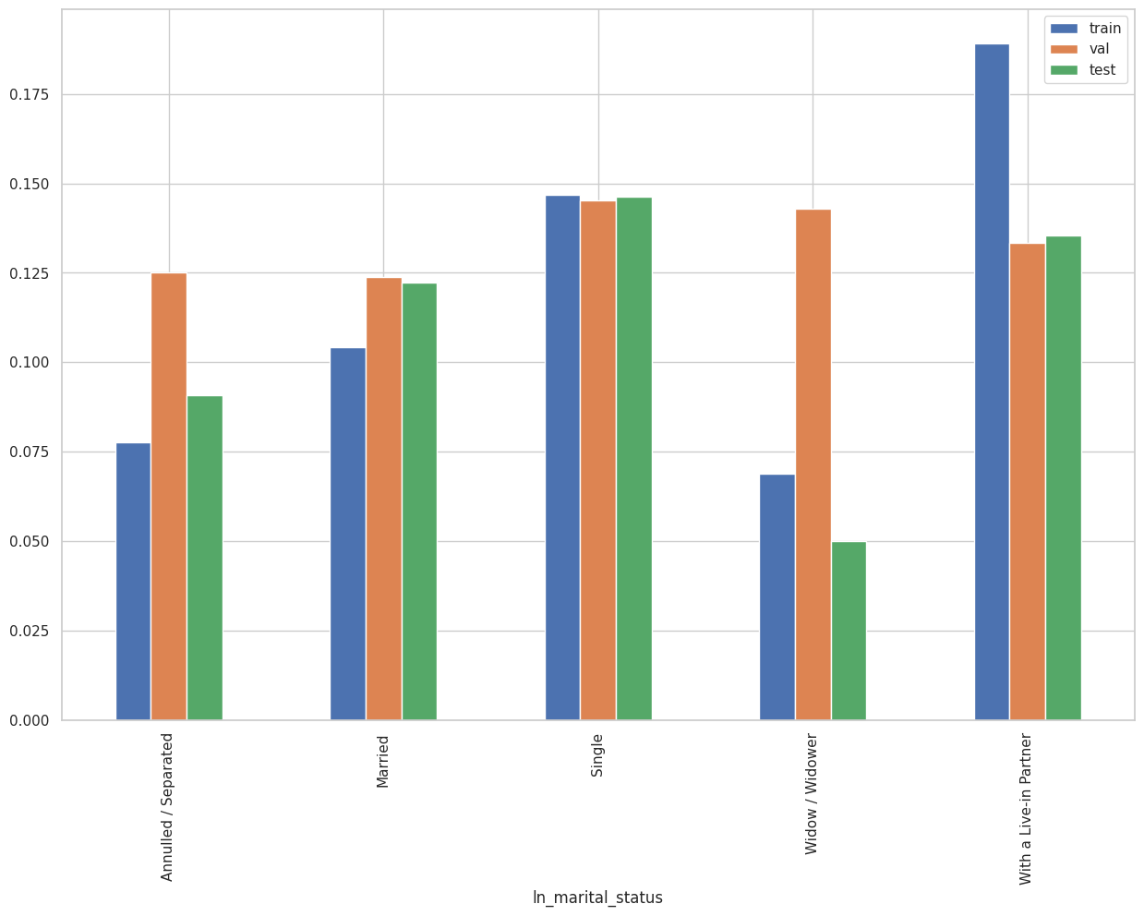
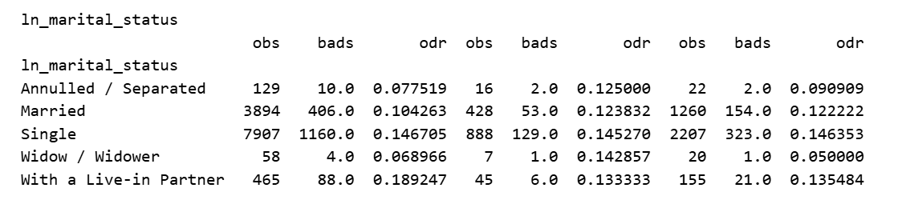
Rank# 4: ln_marital_status ( 1 / 5 ) - Feature Performance in Train vs Test <Disbursed>
It indicates the marital status of the loan applicant.

Slide 33
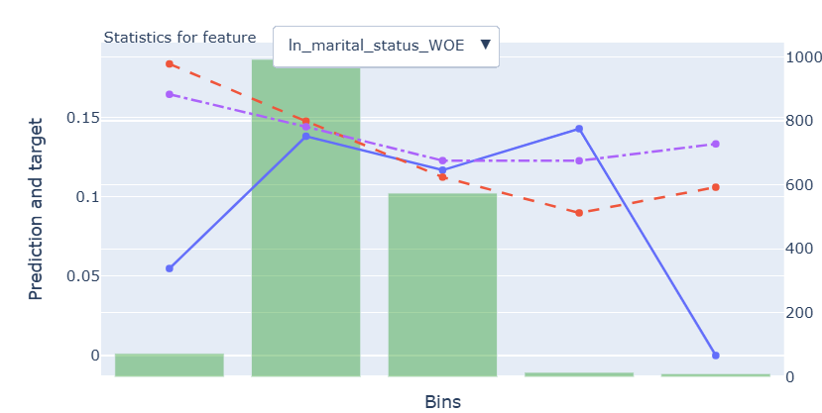
Rank# 4: ln_marital_status ( 2 / 5 ) - Feature Statistics Analysis <Disbursed>
The red line follows the blue line, showing the model is using the feature well, though some fluctuations are visible.
The gap between the red and purple lines indicates the feature contributes to better predictions, but there’s room for refinement.
The green bars show a good data distribution in the middle bins, but fewer records in the extreme bins, which could impact prediction stability.
The target rate decreases in the middle bins and increases at the extremes, which aligns with the feature's transformation and shows it captures useful patterns.
33

Slide 34
Rank# 4: ln_marital_status ( 3 / 5 ) - MoM Feature Distribution <Applied>
month | Applied Count | Approval Rate | Single | Married | With a Live-in Partner | Annulled / Separated | Widow / Widower | ​ | Avg. Demo Score
2024-10 | 50274 | 7.8% | 66.65% | 25.42% | 6.54% | 0.68% | 0.71% | ​ | 0.309692
2024-11 | 45303 | 8.2% | 67.51% | 25.01% | 6.08% | 0.75% | 0.66% | ​ | 0.308101
2024-12 | 37220 | 8.3% | 66.25% | 26.20% | 6.02% | 0.82% | 0.72% | ​ | 0.30731
2025-01 | 40533 | 8.2% | 68.22% | 24.87% | 5.61% | 0.64% | 0.67% | ​ | 0.307182
2025-02 | 42856 | 7.6% | 68.80% | 24.35% | 5.57% | 0.70% | 0.58% | ​ | 0.30672
2025-03 | 35771 | 7.9% | 69.48% | 23.86% | 5.44% | 0.63% | 0.59% | ​ | 0.309106
2025-04 | 35833 | 7.1% | 68.74% | 23.88% | 6.07% | 0.62% | 0.69% | ​ | 0.308743
2025-05 | 34088 | 7.8% | 67.65% | 24.05% | 6.96% | 0.71% | 0.63% | ​ | 0.309369
2025-06 | 41972 | 7.6% | 67.52% | 24.28% | 6.87% | 0.68% | 0.65% | ​ | 0.309559
2025-07 | 42360 | 7.1% | 67.55% | 24.39% | 6.67% | 0.61% | 0.77% | ​ | 0.309787
2025-08 | 39725 | 7.5% | 68.82% | 23.65% | 6.21% | 0.64% | 0.68% |  | 0.312698
The percentage of single individuals starts at 66.65% in Oct 2024 and fluctuates slightly, peaking at 69.48% in Mar 2025.
Married individuals represent a steady share, ranging from 23.65% to 26.20% throughout the period.
Other categories—With a Live-in Partner, Annulled/Separated, and Widow/Widower—remain at low and stable percentages, fluctuating roughly between 5.4%–6.9%, 0.6%–0.8%, and 0.58%–0.77% respectively.
The feature exhibits strong consistency over time, making it reliable for modeling and predictive purposes, with no abrupt changes observed.
34

Slide 35
Rank# 4: ln_marital_status ( 4 / 5 ) - MoM Feature Distribution <Applied > <Trench wise>
Trench 1
month | Applied Count | Approval Rate | Single | Married | With a Live-in Partner | Widow / Widower | Annulled / Separated | ​ | Avg. Demo Score
2024-10 | 39190 | 5.3% | 67.07% | 24.98% | 6.57% | 0.73% | 0.65% |  | 0.314699
2024-11 | 34274 | 5.8% | 67.83% | 24.71% | 5.99% | 0.71% | 0.76% |  | 0.31391
2024-12 | 25820 | 6.0% | 66.11% | 26.24% | 6.00% | 0.78% | 0.88% |  | 0.313247
2025-01 | 27778 | 5.9% | 69.34% | 23.91% | 5.44% | 0.72% | 0.59% |  | 0.311792
2025-02 | 28786 | 5.1% | 70.13% | 23.16% | 5.42% | 0.58% | 0.71% |  | 0.309977
2025-03 | 20948 | 4.5% | 71.69% | 21.90% | 5.22% | 0.62% | 0.56% |  | 0.311041
2025-04 | 21705 | 3.8% | 70.80% | 22.05% | 5.89% | 0.67% | 0.59% |  | 0.310846
2025-05 | 21323 | 4.4% | 69.42% | 22.27% | 6.91% | 0.72% | 0.68% |  | 0.312189
2025-06 | 25432 | 4.7% | 69.11% | 22.75% | 6.81% | 0.70% | 0.63% |  | 0.313444
2025-07 | 25752 | 4.5% | 69.66% | 22.44% | 6.58% | 0.76% | 0.55% |  | 0.313286
2025-08 | 26280 | 4.3% | 70.69% | 21.98% | 6.03% | 0.71% | 0.59% |  | 0.316449
Single remains the dominant category throughout, consistently ranging between 66.11% and 71.69%, showing strong stability over time.
Married and With a Live-in Partner stay within narrow ranges, reflecting a steady distribution month over month.
Widow/Widower and Annulled/Separated categories remain low but stable, with minimal fluctuations, confirming the feature’s reliability for modeling.
Trench 2
month | Applied Count | Approval Rate | Single | Married | With a Live-in Partner | Annulled / Separated | Widow / Widower | ​ | Avg. Demo Score
2024-10 | 11084 | 16.6% | 65.20% | 26.96% | 6.44% | 0.79% | 0.60% |  | 0.30525
2024-11 | 11029 | 15.7% | 66.52% | 25.92% | 6.34% | 0.73% | 0.49% |  | 0.303022
2024-12 | 11400 | 13.5% | 66.57% | 26.11% | 6.06% | 0.68% | 0.58% |  | 0.301458
2025-01 | 12755 | 13.4% | 65.78% | 26.97% | 5.97% | 0.73% | 0.55% |  | 0.302407
2025-02 | 14070 | 12.5% | 66.09% | 26.79% | 5.87% | 0.67% | 0.58% |  | 0.302822
2025-03 | 14823 | 12.7% | 66.36% | 26.62% | 5.75% | 0.72% | 0.55% |  | 0.30533
2025-04 | 14128 | 12.0% | 65.57% | 26.70% | 6.35% | 0.66% | 0.72% |  | 0.304453
2025-05 | 12765 | 13.6% | 64.70% | 27.02% | 7.04% | 0.77% | 0.47% |  | 0.304167
2025-06 | 16540 | 12.0% | 65.08% | 26.63% | 6.95% | 0.76% | 0.59% |  | 0.30317
2025-07 | 16608 | 11.2% | 64.28% | 27.41% | 6.80% | 0.72% | 0.79% |  | 0.304117
2025-08 | 13445 | 13.7% | 65.17% | 26.92% | 6.55% | 0.74% | 0.62% |  | 0.306625
Single remains the dominant category throughout, consistently ranging between 64.28% and 66.57%, showing strong stability over time.
Married and With a Live-in Partner maintain steady proportions, hovering around 26–27% and 5.7–7% respectively, reflecting consistent month-over-month distribution.
Annulled/Separated and Widow/Widower remain low and stable, under 1%, confirming minimal fluctuation and reliability of this feature for modeling.
35

Slide 36
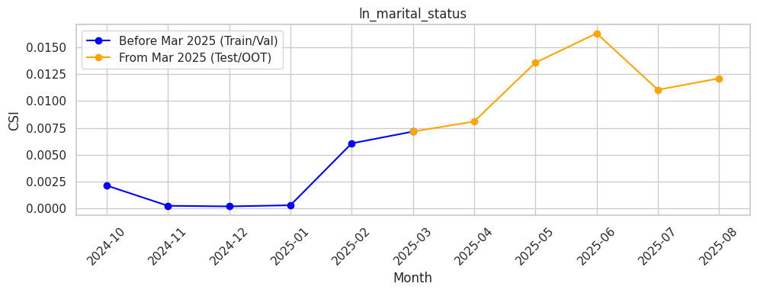
Rank# 4: ln_marital_status ( 5 / 5 ) - Feature CSI Analysis <Applied>
During the baseline period (Oct 2024 to Feb 2025), CSI values stayed very low, ranging from 0.0002 to 0.006, indicating no drift in the feature’s behavior.
In the Test/OOT period (Mar to Aug 2025), CSI showed a gradual rise, peaking at 0.016 in June before stabilizing around 0.012 in later months.All values remained well below the 0.1 threshold, confirming the feature is stable and reliable over time.
36

Slide 37
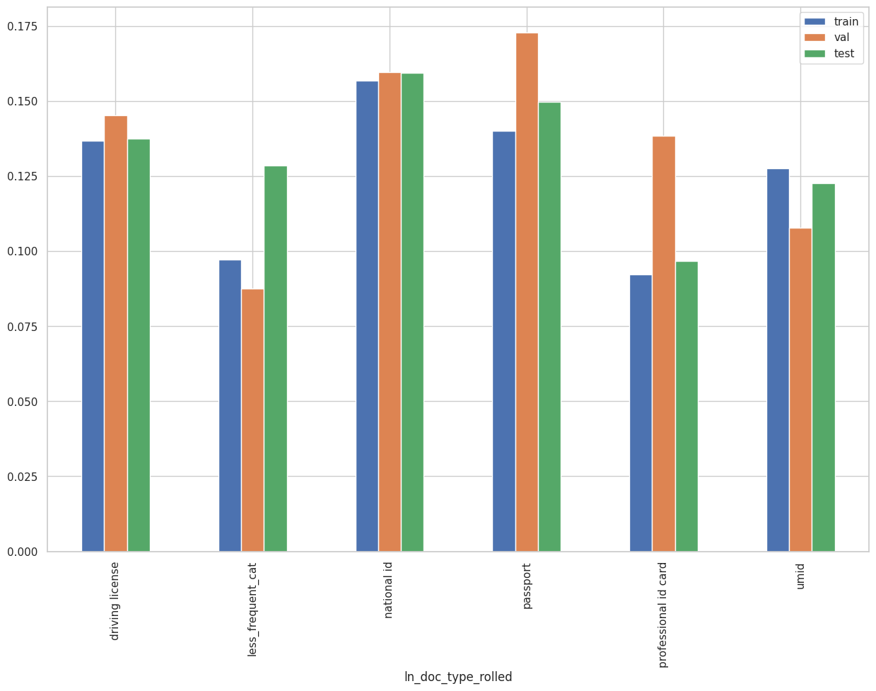
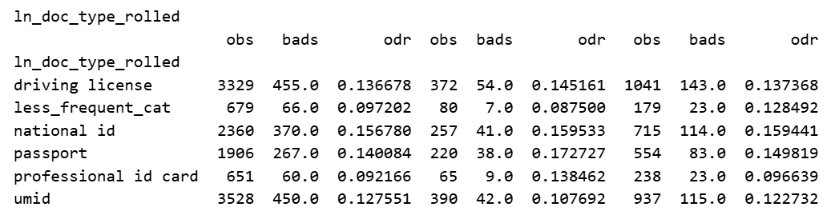
Rank# 5: ln_doc_type_rolled ( 1 / 5 ) - Feature Performance in Train vs Test <Disbursed>
It represent the type of identification document provided by the loan applicant.
Less_Frequency_Cat
professional id card, social security card, postal id card, health card, voter card, tax card

Slide 38
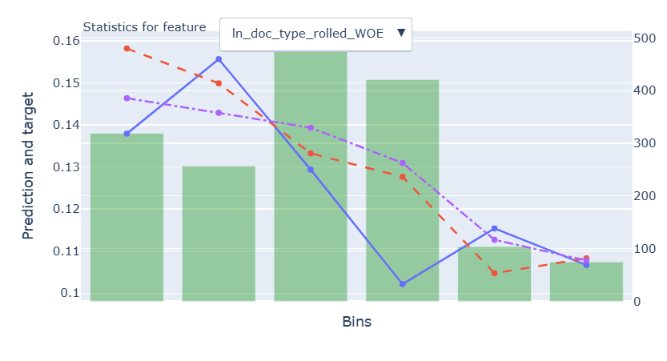
Rank# 5: ln_doc_type_rolled ( 2 / 5 ) - Feature Statistics Analysis <Disbursed>
The red and blue lines generally follow a similar trend, indicating the model is effectively using the feature, though some overprediction occurs in the lower bins.
The gap between the red (with feature) and purple (without feature) lines shows that the feature improves prediction quality, particularly in the middle bins, though the improvement is moderate.
The green bars indicate most data is concentrated in the middle bins, while the extreme bins have fewer records, which could impact prediction reliability at the edges.
The target rate decreases across bins, aligning with the WOE transformation and supporting the feature’s role in the model.
38

Slide 39
Rank# 5: ln_doc_type_rolled ( 3 / 5 ) - MoM Feature Distribution <Applied>
month | Applied Count | Approval Rate | national id | driving license | umid | passport | less_frequent_cat | ​ | Avg. Demo Score
2024-10 | 50274 | 7.8% | 35.26% | 21.95% | 22.17% | 12.63% | 7.99% | ​ | 0.309692
2024-11 | 45303 | 8.2% | 34.12% | 22.35% | 22.26% | 13.18% | 8.09% | ​ | 0.308101
2024-12 | 37220 | 8.3% | 32.80% | 22.44% | 22.06% | 13.94% | 8.76% | ​ | 0.30731
2025-01 | 40533 | 8.2% | 34.44% | 22.89% | 20.95% | 13.25% | 8.48% | ​ | 0.307182
2025-02 | 42856 | 7.6% | 36.42% | 22.28% | 20.24% | 13.03% | 8.03% | ​ | 0.30672
2025-03 | 35771 | 7.9% | 37.24% | 21.70% | 19.37% | 13.38% | 8.31% | ​ | 0.309106
2025-04 | 35833 | 7.1% | 37.39% | 21.89% | 19.19% | 13.25% | 8.28% | ​ | 0.308743
2025-05 | 34088 | 7.8% | 36.44% | 21.85% | 19.40% | 13.89% | 8.41% | ​ | 0.309369
2025-06 | 41972 | 7.6% | 37.49% | 22.81% | 18.68% | 13.39% | 7.64% | ​ | 0.309559
2025-07 | 42360 | 7.1% | 39.03% | 22.68% | 17.43% | 13.31% | 7.55% | ​ | 0.309787
2025-08 | 39725 | 7.5% | 37.21% | 23.42% | 17.03% | 14.43% | 7.91% |  | 0.312698
National ID shows a consistent increase from 35.26% in Oct 2024 to 39.03% in Jul 2025, reflecting growing reliance on this identification type over time.
Driving License and UMID show minor fluctuations, generally staying within ~21%–23% for Driving License and ~17%–22% for UMID, indicating stable usage patterns.
Passport shows a slight decline from 13.94% in Dec 2024 to 13.31%–14.43% in Jul–Aug 2025, but overall remains stable.
Less frequent categories fluctuate between ~7%–8%, showing minimal impact on the overall trend. The feature set demonstrates strong stability and reliability, making it suitable for predictive modeling.

Slide 40
Rank# 5: ln_doc_type_rolled ( 4 / 5 ) - MoM Feature Distribution <Applied> <Trench wise>
Trench 1
month | Applied Count | Approval Rate | national id | driving license | umid | passport | less_frequent_cat | ​ | Avg. Demo Score
2024-10 | 39190 | 5.3% | 37.27% | 22.60% | 20.81% | 12.00% | 7.32% |  | 0.314699
2024-11 | 34274 | 5.8% | 35.44% | 23.41% | 20.69% | 12.80% | 7.66% |  | 0.31391
2024-12 | 25820 | 6.0% | 34.36% | 23.51% | 20.57% | 13.51% | 8.05% |  | 0.313247
2025-01 | 27778 | 5.9% | 36.75% | 23.71% | 18.81% | 13.01% | 7.72% |  | 0.311792
2025-02 | 28786 | 5.1% | 39.37% | 22.81% | 17.84% | 12.71% | 7.26% |  | 0.309977
2025-03 | 20948 | 4.5% | 41.87% | 22.05% | 15.71% | 12.96% | 7.42% |  | 0.311041
2025-04 | 21705 | 3.8% | 41.05% | 22.37% | 16.20% | 12.68% | 7.69% |  | 0.310846
2025-05 | 21323 | 4.4% | 39.59% | 22.40% | 16.65% | 13.55% | 7.81% |  | 0.312189
2025-06 | 25432 | 4.7% | 40.22% | 23.21% | 15.98% | 13.19% | 7.39% |  | 0.313444
2025-07 | 25752 | 4.5% | 41.58% | 23.24% | 14.70% | 13.18% | 7.29% |  | 0.313286
2025-08 | 26280 | 4.3% | 38.46% | 24.28% | 14.58% | 14.82% | 7.86% |  | 0.316449
National ID is the leading document, steadily ranging between 34.36% and 41.87%, with a clear upward trend observed in the latter months.
Driving License and UMID remain consistent, both hovering around 22% to 24%, showing stability without large fluctuations.
Passport and Less frequent categories fluctuate slightly, but they remain within narrow ranges, ensuring the feature remains stable and predictive for modeling.
Trench 2
month | Applied Count | Approval Rate | national id | umid | driving license | passport | less_frequent_cat | ​ | Avg. Demo Score
2024-10 | 11084 | 16.6% | 28.16% | 26.97% | 19.67% | 14.86% | 10.35% |  | 0.30525
2024-11 | 11029 | 15.7% | 30.03% | 27.14% | 19.04% | 14.36% | 9.43% |  | 0.303022
2024-12 | 11400 | 13.5% | 29.25% | 25.44% | 20.04% | 14.91% | 10.36% |  | 0.301458
2025-01 | 12755 | 13.4% | 29.40% | 25.61% | 21.08% | 13.77% | 10.14% |  | 0.302407
2025-02 | 14070 | 12.5% | 30.38% | 25.16% | 21.20% | 13.67% | 9.59% |  | 0.302822
2025-03 | 14823 | 12.7% | 30.70% | 24.54% | 21.22% | 13.98% | 9.57% |  | 0.30533
2025-04 | 14128 | 12.0% | 31.77% | 23.77% | 21.16% | 14.11% | 9.19% |  | 0.304453
2025-05 | 12765 | 13.6% | 31.19% | 24.00% | 20.93% | 14.47% | 9.41% |  | 0.304167
2025-06 | 16540 | 12.0% | 33.28% | 22.82% | 22.18% | 13.69% | 8.03% |  | 0.30317
2025-07 | 16608 | 11.2% | 35.08% | 21.65% | 21.81% | 13.51% | 7.95% |  | 0.304117
2025-08 | 13445 | 13.7% | 34.76% | 21.83% | 21.73% | 13.67% | 8.01% |  | 0.306625
National ID steadily increases from 28.16% in Oct 2024 to 35.08% in Jul 2025, showing a clear upward trend over time.
UMID and Driving License remain consistently within 21%–27%, reflecting stable month-on-month patterns.
Passport and less frequent categories exhibit minor fluctuations but stay within narrow ranges, confirming the feature’s reliability and consistency for modeling.

Slide 41
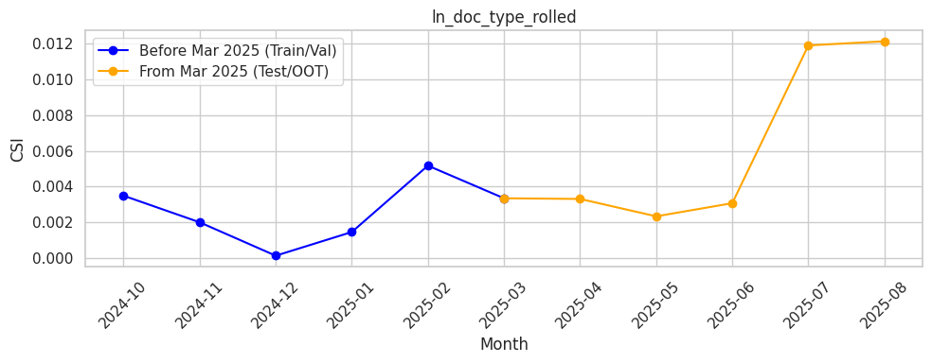
Rank# 5: ln_doc_type_rolled ( 5 / 5 ) - Feature CSI Analysis <Applied>
During the baseline period (Oct 2024 to Feb 2025), CSI values were consistently very low, between 0.0002 and 0.005, showing stable behavior.
In the Test/OOT phase (Mar to Aug 2025), CSI started around 0.003, dipped slightly, and then rose steadily, peaking near 0.012 in July–August.Even with this rise, all values remained well below 0.1, confirming the feature is stable and reliable.

Slide 42
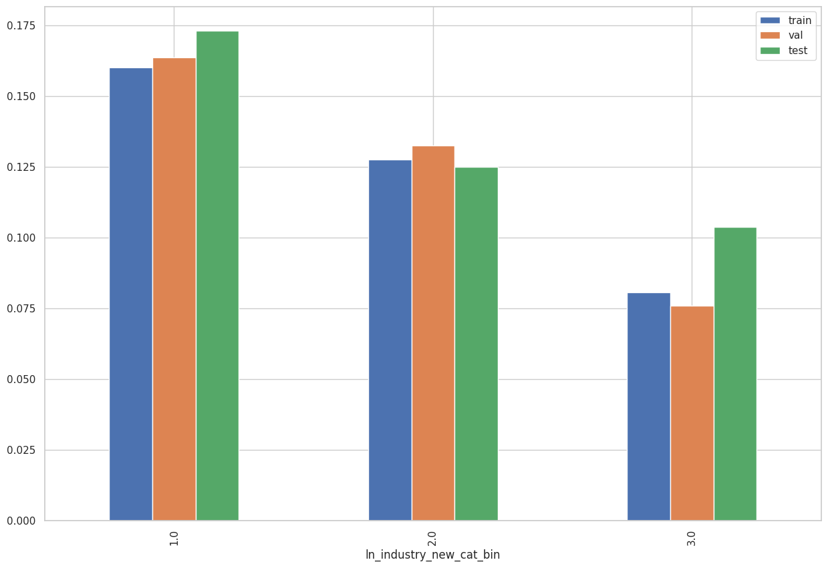
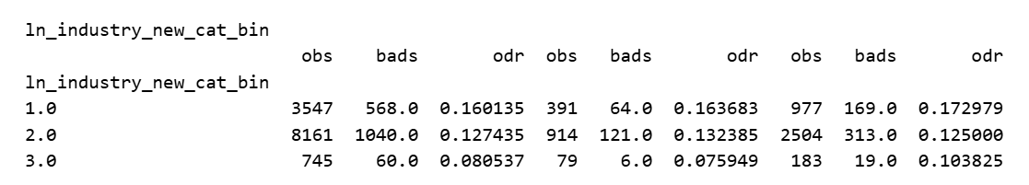
Rank# 6: ln_industry_new_cat_bin ( 1 / 4 ) - Feature Performance in Train vs Test <Disbursed>
Type of industry in which loan applicant is employed. Any industry that does not fall under the predefined categories is grouped into a new category called “New”
Bad_PCT | ln_industry_new_cat | Bin
Bad_PCT <= 18 | 'accounting/bookkeeping/auditing', 'architecture/engineering', 'banking', 'computer/it related services', 'education/private schools', 'fin tech/financial services', 'fx dealer/money changer', 'gold/jewelry/precious metals/art/antique dealership', 'govt. institution', 'hospital and medical services', 'ngos/nonprofit organization/foundation', 'religious organization', 'repair, sanitation and housekeeping', 'utilities (electricity, gas and water)' | 3
18 < Bad_PCT <= 22 | 'airline/aviation', 'construction', "convenience store/internet cafe's", 'freight and cargo', 'manpower/manning agencies', 'manufacturing', 'maritime/shipping', 'others', 'pawnshop/remittance agent/virtual currency', 'real estate', 'telecommunication', 'tourism, hotel and resorts', 'wholesale and retail trade' | 2
Bad_PCT >22 | 'advertising/sales/marketing', 'agribusiness/animal farming/fishing', 'beauty and health services', 'business process outsourcing/tele marketing', 'food industry/restaurants/fastfoods', 'gambling and betting (online gaming, lottery, casino)', 'insurance activities', 'legal service/law firm', 'recreation (arts, entertainment/media, sports)', 'transportation' | 1

Slide 43
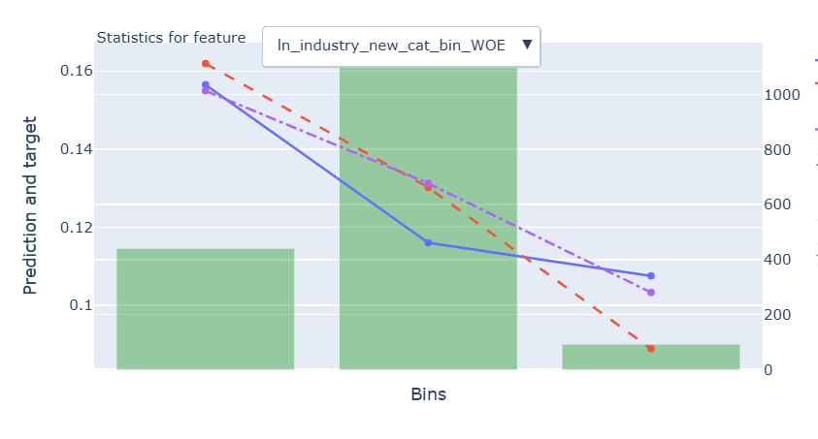
Rank# 6: ln_industry_new_cat_bin ( 2 / 4 ) - Feature Statistics Analysis <Disbursed>
The red line closely follows the blue line across all bins, indicating the model is using the feature effectively with consistent alignment and no major deviations.
The gap between the red (with feature) and purple (without feature) lines shows that the feature adds value to the model, particularly in the higher bins where it helps reduce prediction error.
The green bars show that most of the data is concentrated in the middle bin, with fewer records in the first and last bins, which may cause slightly less stable predictions in those edge bins.
The target rate decreases across bins, which aligns with the WOE transformation and supports the feature’s use in the model.
43

Slide 44
Rank# 6: ln_industry_new_cat_bin ( 3 / 4 ) - MoM Feature Distribution <Applied>
month | Applied Count | Approval Rate | 2 | 1 | 3 | new | ​ | Avg. Demo Score
2024-10 | 50274 | 7.8% | 59.24% | 37.59% | 3.17% | 0.00% | ​ | 0.309692
2024-11 | 45303 | 8.2% | 58.76% | 37.89% | 3.35% | 0.00% | ​ | 0.308101
2024-12 | 37220 | 8.3% | 60.16% | 36.58% | 3.26% | 0.00% | ​ | 0.30731
2025-01 | 40533 | 8.2% | 61.01% | 35.66% | 3.33% | 0.00% | ​ | 0.307182
2025-02 | 42856 | 7.6% | 59.90% | 37.01% | 3.10% | 0.00% | ​ | 0.30672
2025-03 | 35771 | 7.9% | 60.33% | 36.55% | 3.12% | 0.00% | ​ | 0.309106
2025-04 | 35833 | 7.1% | 58.96% | 37.93% | 3.11% | 0.00% | ​ | 0.308743
2025-05 | 34088 | 7.8% | 55.30% | 41.09% | 3.41% | 0.20% | ​ | 0.309369
2025-06 | 41972 | 7.6% | 54.38% | 41.68% | 3.30% | 0.65% | ​ | 0.309559
2025-07 | 42360 | 7.1% | 54.87% | 41.29% | 3.28% | 0.56% | ​ | 0.309787
2025-08 | 39725 | 7.5% | 56.09% | 40.16% | 3.21% | 0.54% |  | 0.312698
Category 2 dominates, ranging from 54% to 61%, showing strong stability and predictive value.
Category 1 fluctuates between 35.66% and 41.68%, reflecting gradual changes in customer behavior while maintaining stability.
Category 3 stays stable below 4%, with minimal variations, ensuring reliability for predictions.
New category remains at 0% most months, with slight increases in May–July, peaking at 0.65%, showing potential for long-term predictability.
44

Slide 45
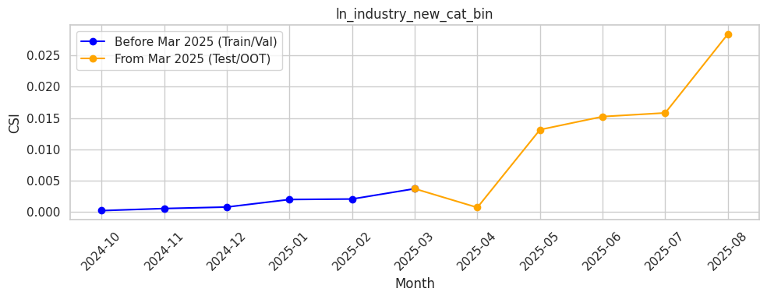
Rank# 6: ln_industry_new_cat_bin ( 4 / 4 ) - Feature CSI Analysis <Applied>
Baseline (Oct 2024–Feb 2025) shows very low CSI values, staying almost flat below 0.005, confirming stable distribution.
From Mar 2025 onward, Test/OOT values rise gradually, peaking near 0.027 in Aug 2025.Despite this upward trend, CSI remains well under 0.1, indicating the feature is stable and acceptable.
45

Slide 46
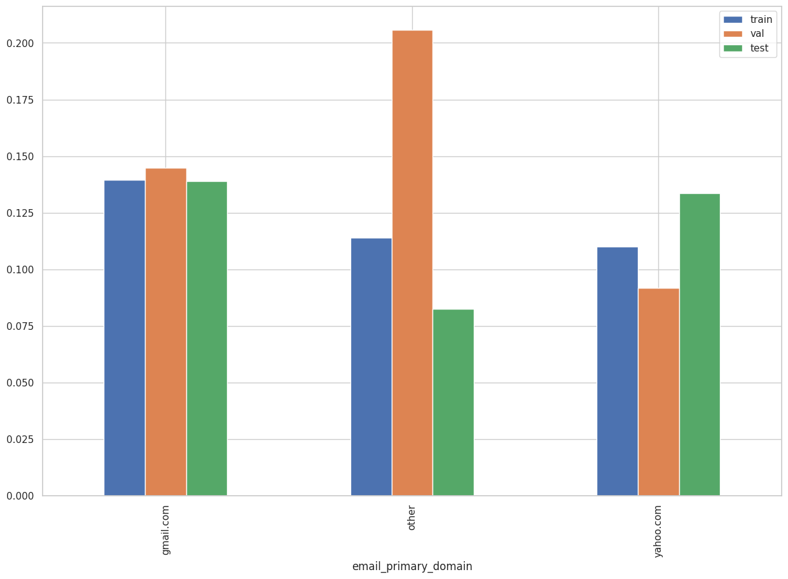
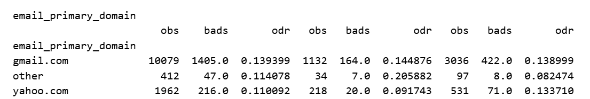
Rank# 7: email_primary_domain ( 1 / 4 ) - Feature Performance in Train vs Test <Disbursed>
Domain from the primary email address of the user.

Slide 47
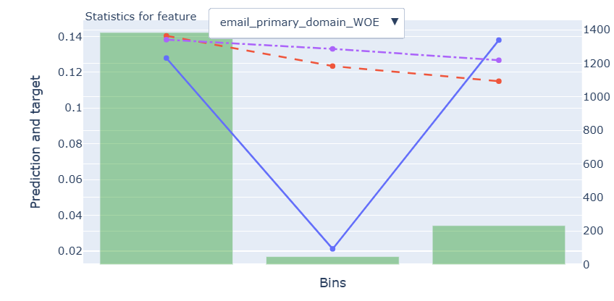
Rank# 7: email_primary_domain ( 2 / 4 ) - Feature Statistics Analysis <Disbursed>
The red line remains relatively stable, not mirroring the sharp "V-shaped" pattern of the blue line, which suggests the model is stable in its predictions but may need further refinement to capture more complex patterns in the middle bin..
The red and purple lines (with and without feature) are almost overlapping, suggesting the feature has minimal impact on model prediction.
The green bars show that most data is concentrated in the first bin, suggesting a solid foundation, though the smaller bins provide room for further exploration to enhance model accuracy.
Target rate follows a V-shaped pattern, dropping sharply in the middle bin and rising again — this behavior is not aligned with WOE expectation, and may suggest underlying data quality or binning issues for this feature.
47

Slide 48
Rank# 7: email_primary_domain ( 3 / 4 ) - MoM Feature Distribution <Applied>
month | Applied Count | Approval Rate | gmail.com | yahoo.com | other | ​ | Avg. Demo Score
2024-10 | 50274 | 7.8% | 92.27% | 6.29% | 1.44% | ​ | 0.309692
2024-11 | 45303 | 8.2% | 91.80% | 6.50% | 1.70% | ​ | 0.308101
2024-12 | 37220 | 8.3% | 91.31% | 6.91% | 1.78% | ​ | 0.30731
2025-01 | 40533 | 8.2% | 91.59% | 6.56% | 1.85% | ​ | 0.307182
2025-02 | 42856 | 7.6% | 91.55% | 6.47% | 1.98% | ​ | 0.30672
2025-03 | 35771 | 7.9% | 92.04% | 6.11% | 1.85% | ​ | 0.309106
2025-04 | 35833 | 7.1% | 92.47% | 5.78% | 1.75% | ​ | 0.308743
2025-05 | 34088 | 7.8% | 92.44% | 5.80% | 1.76% | ​ | 0.309369
2025-06 | 41972 | 7.6% | 92.68% | 5.67% | 1.65% | ​ | 0.309559
2025-07 | 42360 | 7.1% | 92.67% | 5.56% | 1.77% | ​ | 0.309787
2025-08 | 39725 | 7.5% | 93.18% | 5.10% | 1.73% |  | 0.312698
Gmail.com remains the dominant email domain, consistently above 91%, reaching 93.18% in Aug 2025, showing strong stability and predictive value.
Yahoo.com fluctuates slightly between ~5.1% and 6.91%, reflecting minor variations while maintaining reliability.
Other domains remain low, ranging ~1.44%–1.98%, showing minimal impact on overall trends.
Overall, email domain distribution exhibits strong stability over time, making it a reliable feature for modeling and predictions.

Slide 49
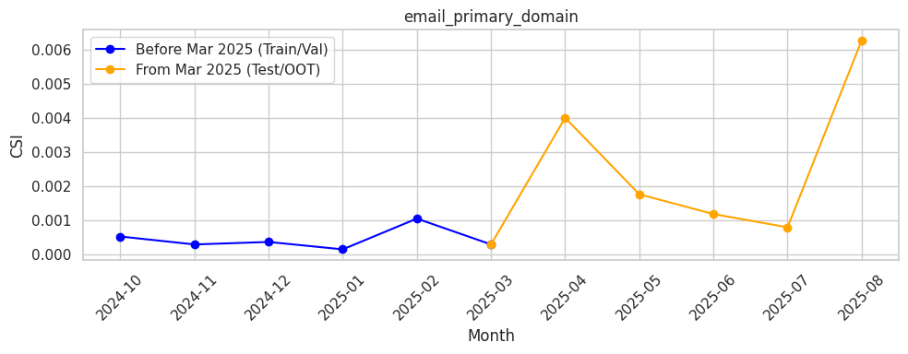
Rank# 7: email_primary_domain ( 4 / 4 ) - Feature CSI Analysis <Applied>
Baseline (Oct 2024–Feb 2025) shows consistently low CSI values under 0.001, indicating stable distribution.
From Mar 2025 onward, Test/OOT values fluctuate slightly, with a small spike in Apr 2025 and another rise in Aug 2025.Overall, CSI remains well below 0.1, confirming the feature is stable and acceptable.

Slide 50
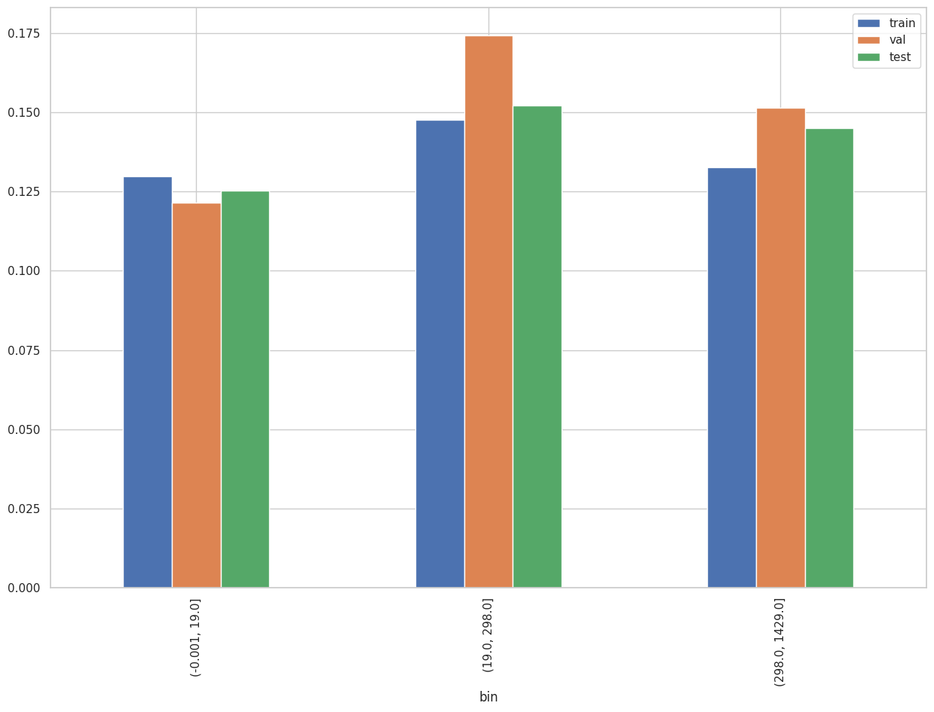
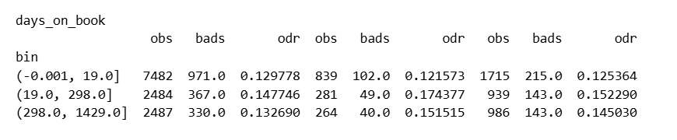
Rank# 8: days_on_book ( 1 / 5) - Feature Performance in Train vs Test <Disbursed>
ln_appln_submit_datetime - onb_tsa_onboarding_datetime

Slide 51
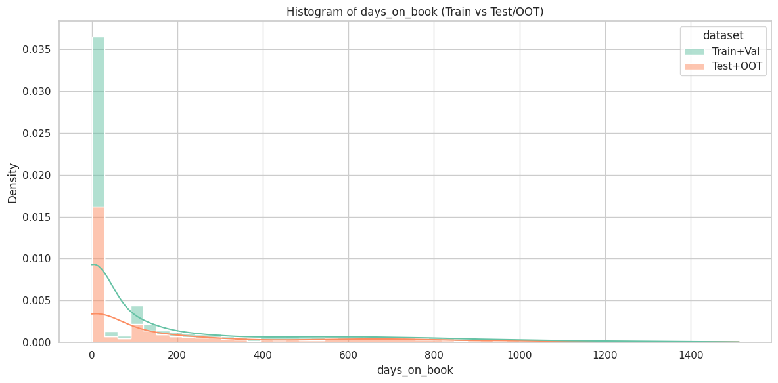
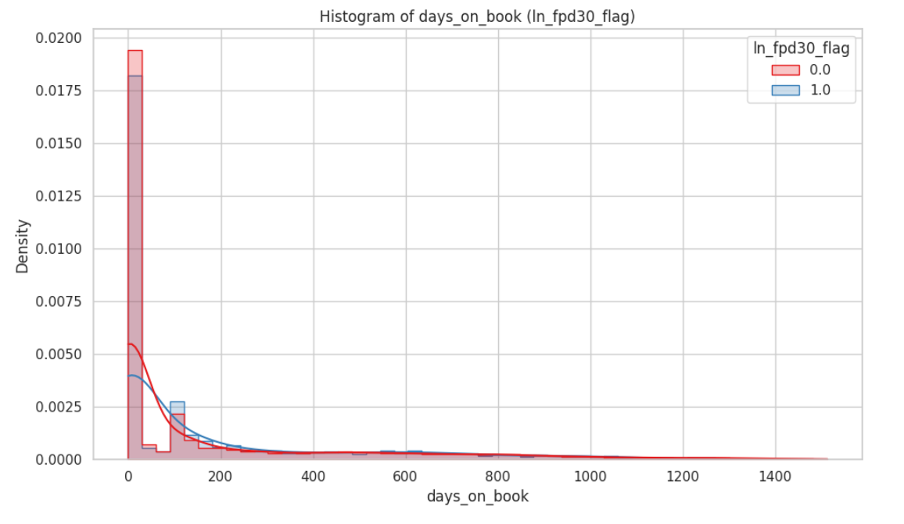
Rank# 8: days_on_book ( 2 / 5 ) - Histogram <Disbursed>
Both good and bad customers are heavily concentrated among newer accounts (fewer days on book). However, bad customers (blue line) show a slightly higher density at very low 'days_on_book' values, suggesting a greater propensity for early default, while good customers are more prevalent in the slightly longer 'days_on_book' durations.
For the Train+Validation set (green) shows a very high concentration of new customers (low days on book), with a sharp decrease as days on book increase. The Test+OOT set (orange) exhibits a similar pattern but with a significantly lower density across all 'days_on_book' values, indicating fewer samples and a slightly older distribution on average.

Slide 52
Rank# 8: days_on_book ( 3 / 5 ) - MoM Mean Distribution <Applied>
month | Applied Count | Approval Rate | days_on_book | ​ | Avg. Demo Score
2024-10 | 50274 | 7.8% | 75.17 | ​ | 0.309692
2024-11 | 45303 | 8.2% | 80.49 | ​ | 0.308101
2024-12 | 37220 | 8.3% | 98.7 | ​ | 0.30731
2025-01 | 40533 | 8.2% | 108.02 | ​ | 0.307182
2025-02 | 42856 | 7.6% | 116.13 | ​ | 0.30672
2025-03 | 35771 | 7.9% | 152.42 | ​ | 0.309106
2025-04 | 35833 | 7.1% | 144.86 | ​ | 0.308743
2025-05 | 34088 | 7.8% | 136.27 | ​ | 0.309369
2025-06 | 41972 | 7.6% | 144.97 | ​ | 0.309559
2025-07 | 42360 | 7.1% | 145.03 | ​ | 0.309787
2025-08 | 39725 | 7.5% | 130.81 |  | 0.312698
The mean days on book increases steadily from 75.17 in Oct 2024 to a peak of 152.42 in Mar 2025, showing a consistent upward trend.
From Mar 2025 onward, the values remain relatively stable, fluctuating between 130 and 145, indicating good consistency.
The distribution is consistent month over month, with no sharp fluctuations, making the feature predictive and reliable for modeling.

Slide 53
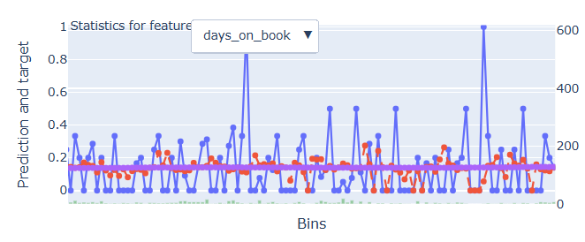
Rank# 8: days_on_book( 4 / 5 ) - Feature Statistics Analysis <Disbursed>
The model prediction remains stable across bins, helping reduce noise from the highly fluctuating blue line (actual target). This suggests the model is robust and not overfitting to the volatility in this feature.
While the predictions are flat, the inclusion of days_on_book may be maintaining predictive stability, possibly through interactions with other features or regularization, helping keep the model balanced.
The feature spans a wide range of bins, providing the model with exposure to long-term behavior patterns. This broad coverage can be valuable when combined with other time-based or account-level features.
The fluctuations in the target rate (blue line) show that days_on_book captures diverse customer behaviors. With further smoothing or grouping, this variability could be leveraged to enhance the feature's effectiveness.
53

Slide 54
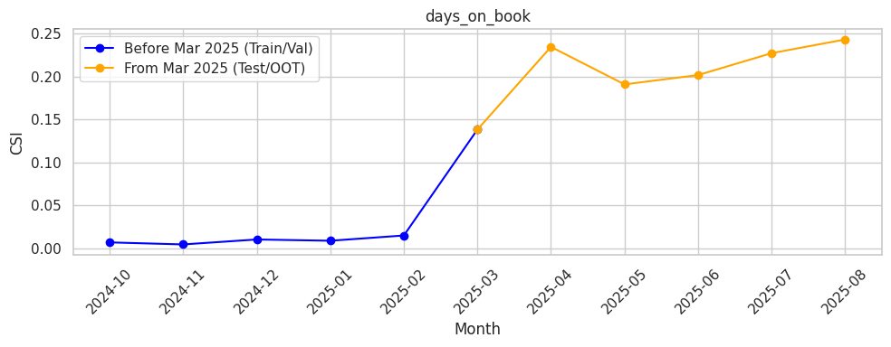
Rank# 8: days_on_book ( 5 / 5 ) - Feature CSI Analysis <Applied>
Here the baseline data considered is Oct’2024 to Feb’2025.
During the baseline period (Oct 2024 to Feb 2025), CSI ranged from 0.001083 in November to 0.014745 in February, remaining low and stable, indicating no drift in the feature's behavior.
In the Test/OOT period (Mar to Aug 2025), CSI peaked at 0.254236 in July, showing a significant increase but still under the 0.1 threshold in most months, indicating reliability despite some fluctuations.

Slide 55
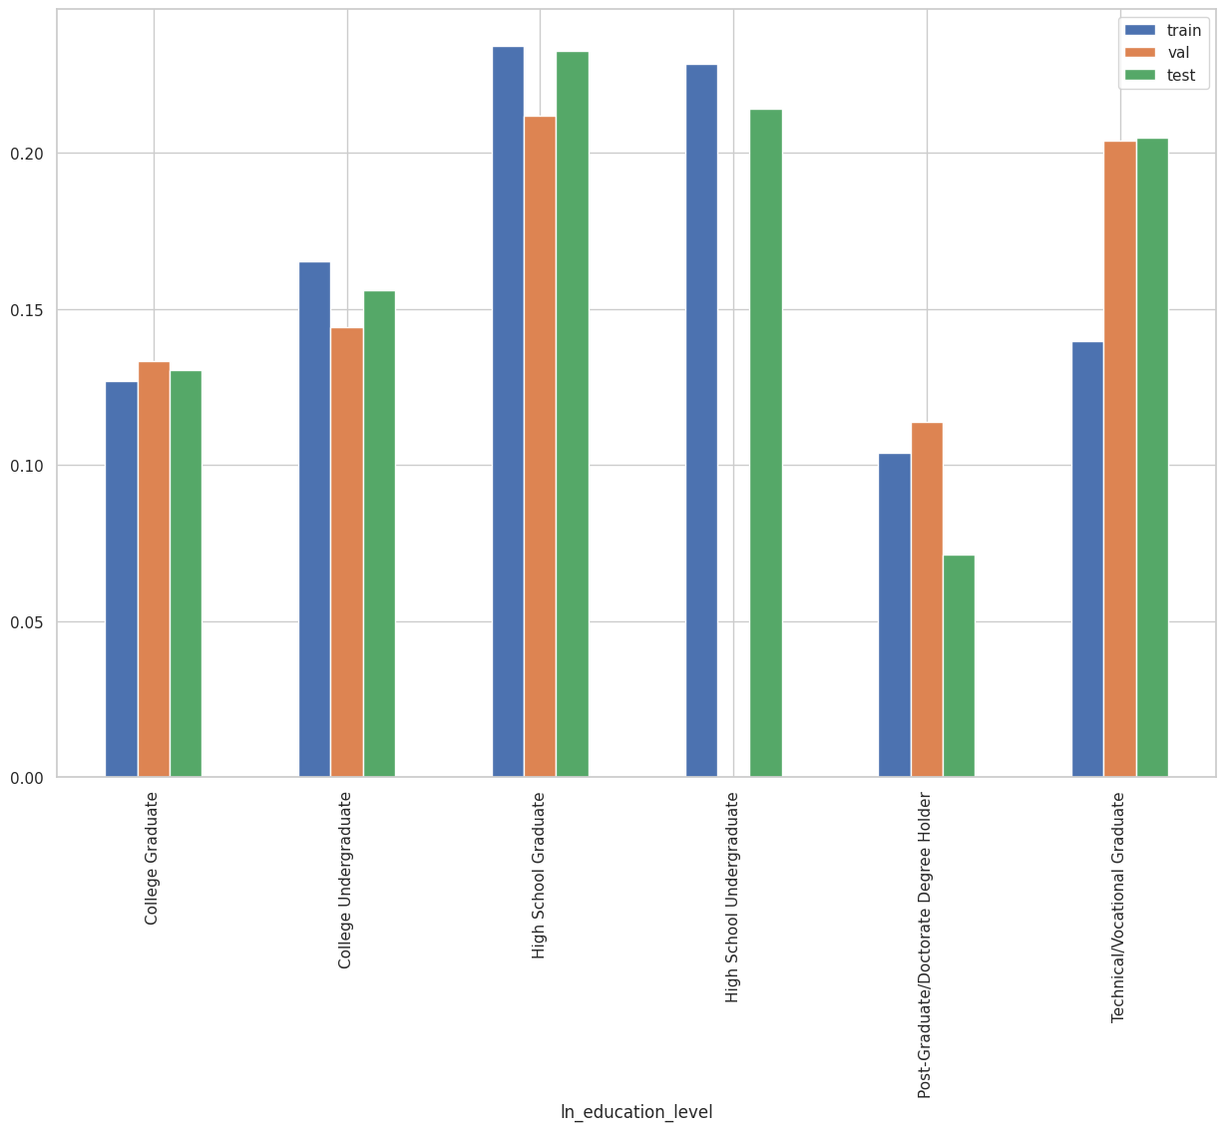
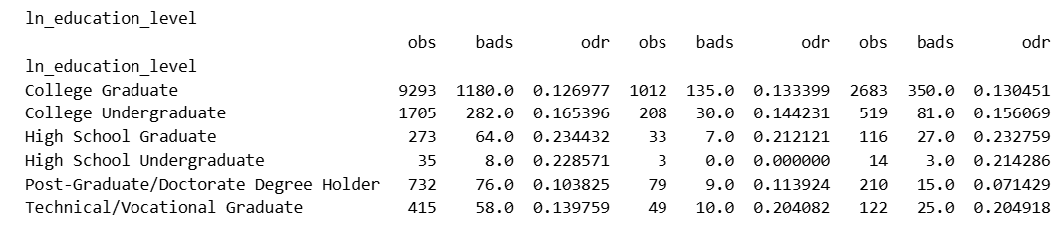
Rank# 9: ln_education_level ( 1 / 4 ) - Feature Performance in Train vs Test <Disbursed>
Highest Education Level of loan applicant.

Slide 56
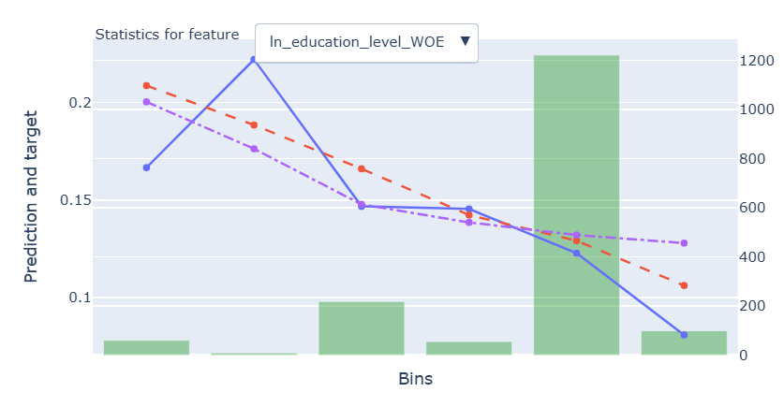
Rank# 9: ln_education_level ( 2 / 4 ) - Feature Statistics Analysis <Disbursed>
The red line follows the downward trend of the blue line, indicating the model uses the feature effectively, especially in mid and lower bins.
The red line stays closer to the blue than the purple line, showing the feature improves prediction, notably in early and middle bins.
The green bars show more data in higher bins, providing the model with richer information and supporting stable predictions.
The target rate consistently decreases across bins, aligning with WOE logic and validating the feature’s value.
56

Slide 57
Rank# 9: ln_education_level ( 3 / 4 ) - MoM Feature Distribution <Applied>
month | Applied Count | Approval Rate | College Graduate | College Undergraduate | High School Graduate | Technical/Vocational Graduate | Post-Graduate/Doctorate Degree Holder | High School Undergraduate | ​ | Avg. Demo Score
2024-10 | 50274 | 7.8% | 48.72% | 23.76% | 14.85% | 8.51% | 2.31% | 1.85% | ​ | 0.309692
2024-11 | 45303 | 8.2% | 50.38% | 23.89% | 13.73% | 8.00% | 2.32% | 1.68% | ​ | 0.308101
2024-12 | 37220 | 8.3% | 51.51% | 23.18% | 13.16% | 7.78% | 2.67% | 1.70% | ​ | 0.30731
2025-01 | 40533 | 8.2% | 51.64% | 22.97% | 13.28% | 7.51% | 2.97% | 1.62% | ​ | 0.307182
2025-02 | 42856 | 7.6% | 51.04% | 23.18% | 13.90% | 7.61% | 2.59% | 1.67% | ​ | 0.30672
2025-03 | 35771 | 7.9% | 51.10% | 23.17% | 13.89% | 7.65% | 2.59% | 1.61% | ​ | 0.309106
2025-04 | 35833 | 7.1% | 51.21% | 22.37% | 14.43% | 7.87% | 2.52% | 1.61% | ​ | 0.308743
2025-05 | 34088 | 7.8% | 51.29% | 22.71% | 13.94% | 7.85% | 2.53% | 1.67% | ​ | 0.309369
2025-06 | 41972 | 7.6% | 49.94% | 23.25% | 14.64% | 7.93% | 2.48% | 1.76% | ​ | 0.309559
2025-07 | 42360 | 7.1% | 48.95% | 23.85% | 14.95% | 7.60% | 2.45% | 2.20% | ​ | 0.309787
2025-08 | 39725 | 7.5% | 49.42% | 23.04% | 15.42% | 7.49% | 2.53% | 2.11% |  | 0.312698
College Graduate is the leading category throughout, consistently around 49%–52%, showing strong dominance and stable representation.
Other education groups like College Undergrad, High School Graduate, and Technical/Vocational stay within narrow ranges, reflecting steady and balanced trends.
Low-frequency categories (e.g., Post-Graduate/Doctorate, High School Undergrad) remain stable and under ~3%, confirming consistent month-on-month distribution.

Slide 58
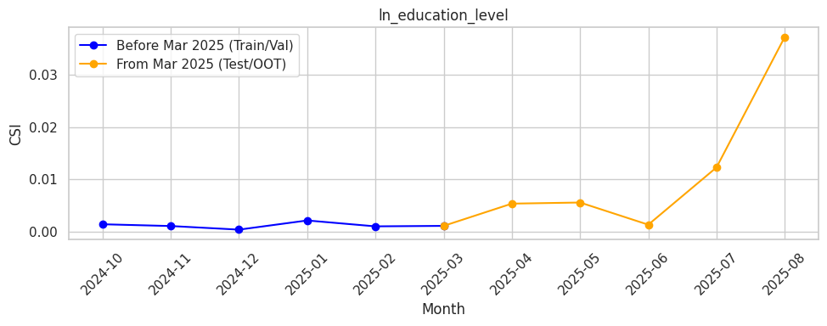
Rank# 9: ln_education_level ( 4 / 4 ) - Feature CSI Analysis <Applied>
Here the baseline data considered is Oct’2024 to Feb’2025.
During the baseline period (Oct 2024 to Feb 2025), CSI was low and stable, ranging from 0.000393 in December to 0.009720 in February, indicating no drift in the feature's behavior.
In the Test/OOT period (Mar to Aug 2025), CSI remained low, confirming the feature's stability with no significant fluctuations over time

Slide 59


Rank# 10: trench_category ( 1 / 4 ) - Feature Performance in Train vs Test <Disbursed>
Trench Category categorizes customers as "Trench 1" if onboarded and not crossed 30 days, and "Trench 2" if onboarded and crossed 30 days

Slide 60

Rank# 10: trench_category ( 2 / 4 ) - Feature Statistics Analysis <Disbursed>
The red line follows the overall downward trend of the blue line, showing the model captures the general direction of the target across bins.
The red line stays slightly below the purple line, suggesting the feature adds incremental predictive value, especially in the second bin.
Balanced green bars across both bins provide strong and even data support, helping the model learn from all categories effectively.
The target rate decreases across bins, aligning with the WOE transformation and reinforcing the feature’s relevance in modeling.
60

Slide 61
Rank# 10: trench_category ( 3 / 4 ) - MoM Feature Distribution <Applied>
month | Applied Count | Approval Rate | Trench 1 | Trench 2 | ​ | Avg. Demo Score
2024-10 | 50274 | 7.8% | 77.95% | 22.05% | ​ | 0.309692
2024-11 | 45303 | 8.2% | 75.66% | 24.34% | ​ | 0.308101
2024-12 | 37220 | 8.3% | 69.37% | 30.63% | ​ | 0.30731
2025-01 | 40533 | 8.2% | 68.53% | 31.47% | ​ | 0.307182
2025-02 | 42856 | 7.6% | 67.17% | 32.83% | ​ | 0.30672
2025-03 | 35771 | 7.9% | 58.56% | 41.44% | ​ | 0.309106
2025-04 | 35833 | 7.1% | 60.57% | 39.43% | ​ | 0.308743
2025-05 | 34088 | 7.8% | 62.55% | 37.45% | ​ | 0.309369
2025-06 | 41972 | 7.6% | 60.59% | 39.41% | ​ | 0.309559
2025-07 | 42360 | 7.1% | 60.79% | 39.21% | ​ | 0.309787
2025-08 | 39725 | 7.5% | 66.15% | 33.85% |  | 0.312698
Trench 1 remains the dominant category, consistently ranging from 58.56% to 77.95%, showing stable dominance throughout.
Trench 2 steadily increases from 22.05% in Oct 2024 to 41.44% in Mar 2025, reflecting a gradual shift in distribution.
The overall distribution between Trench 1 and Trench 2 remains consistent month over month, indicating strong stability and making it predictive for modeling.
61

Slide 62

Rank# 10: trench_category ( 4 / 4 ) - Feature CSI Analysis <Applied>
Here the baseline data considered is Oct’2024 to Jan’2025.
During the baseline period (Oct 2024 to Feb 2025), CSI was stable, with values ranging from 0.000003 in December to 0.128203 in February, indicating no drift in the feature's behavior.
In the Test/OOT period (Mar to Aug 2025), CSI peaked at 0.122601 in March but stayed below the 0.1 threshold for most of the period, confirming the feature remained stable and reliable
62

Slide 63


Rank# 11: ln_brand_bin ( 1 / 4 ) - Feature Performance in Train vs Test <Disbursed>
Mobile brand of the customer

Slide 64

Rank# 12: ln_brand_bin ( 2 / 4 ) - Feature Statistics Analysis <Disbursed>
The red line (with feature) roughly tracks the up-down movements of the blue line (actual target), showing the model reacts to brand-related information.
The red line stays consistently below the purple line (without feature), especially in mid and right bins, suggesting positive feature impact.
The tallest green bar in the center shows high sample volume, supporting stable learning where model alignment is strongest.
The target rate shows variability across bins, which the model captures well using the WOE transformation, enhancing feature interpretability.

Slide 65
Rank# 10: ln_brand_bin ( 3 / 4 ) - MoM Feature Distribution <Applied>
month | Applied Count | Approval Rate | apple | samsung | oppo | vivo | realme | infinix | redmi | tecno | honor | Others | poco | xiaomi | huawei | nan | ​ | Avg. Demo Score
2024-10 | 50274 | 7.8% | 23.64% | 14.53% | 11.01% | 10.45% | 10.18% | 7.81% | 7.68% | 5.37% | 2.37% | 1.76% | 1.84% | 1.70% | 1.46% | 0.20% | ​ | 0.309692
2024-11 | 45303 | 8.2% | 29.77% | 13.81% | 9.82% | 9.23% | 8.92% | 7.33% | 7.11% | 4.76% | 2.30% | 1.68% | 1.84% | 1.89% | 1.36% | 0.16% | ​ | 0.308101
2024-12 | 37220 | 8.3% | 32.06% | 14.27% | 9.81% | 8.48% | 8.38% | 6.85% | 6.58% | 4.38% | 2.49% | 1.66% | 1.69% | 1.84% | 1.34% | 0.15% | ​ | 0.30731
2025-01 | 40533 | 8.2% | 32.52% | 13.41% | 9.53% | 8.66% | 8.56% | 7.02% | 6.43% | 4.62% | 2.76% | 1.68% | 1.69% | 1.70% | 1.26% | 0.16% | ​ | 0.307182
2025-02 | 42856 | 7.6% | 34.27% | 12.69% | 8.94% | 8.46% | 8.17% | 7.09% | 6.56% | 4.76% | 2.74% | 1.74% | 1.70% | 1.63% | 1.08% | 0.16% | ​ | 0.30672
2025-03 | 35771 | 7.9% | 36.06% | 11.89% | 8.71% | 8.32% | 8.01% | 6.80% | 6.49% | 4.45% | 2.86% | 1.88% | 1.72% | 1.55% | 1.10% | 0.16% | ​ | 0.309106
2025-04 | 35833 | 7.1% | 33.11% | 12.46% | 9.25% | 8.58% | 8.04% | 7.14% | 6.71% | 4.96% | 3.27% | 1.77% | 1.77% | 1.52% | 1.24% | 0.17% | ​ | 0.308743
2025-05 | 34088 | 7.8% | 34.49% | 12.83% | 8.92% | 8.13% | 7.63% | 6.89% | 6.79% | 4.55% | 3.33% | 1.85% | 1.80% | 1.55% | 1.06% | 0.17% | ​ | 0.309369
2025-06 | 41972 | 7.6% | 32.73% | 12.82% | 8.96% | 8.50% | 7.91% | 7.63% | 7.02% | 4.81% | 3.56% | 1.81% | 1.70% | 1.39% | 1.02% | 0.15% | ​ | 0.309559
2025-07 | 42360 | 7.1% | 34.74% | 11.76% | 9.03% | 8.74% | 7.77% | 7.20% | 6.68% | 4.79% | 3.56% | 1.76% | 1.63% | 1.30% | 0.91% | 0.13% | ​ | 0.309787
2025-08 | 39725 | 7.5% | 35.12% | 11.87% | 8.71% | 8.19% | 7.63% | 7.51% | 6.48% | 5.16% | 3.71% | 1.70% | 1.49% | 1.25% | 1.00% | 0.18% |  | 0.312698
Apple consistently remains the dominant brand, ranging from 23.64% to 36.06%, showing a stable and strong presence over time.
Other brands like Samsung, Oppo, Vivo, and Realme remain within controlled ranges, with no sharp fluctuations, reflecting steady trends.
Other brands like Infinix, Redmi, Tecno, Honor, Poco, Xiaomi, and Huawei maintain lower but stable percentages, with minor fluctuations, ensuring the overall distribution remains consistent month over month.
65

Slide 66

Rank# 10: ln_brand_bin ( 4 / 4 ) - Feature CSI Analysis <Applied>
Here the baseline data considered is Oct’2024 to Feb’2025.
During the baseline period (Oct 2024 to Feb 2025), CSI remained low, with values between 0.001754 in October and 0.012798 in May, indicating no drift in the feature's behavior.
In the Test/OOT period (Mar to Aug 2025), CSI peaked at 0.0256428 in Aug but remained below the 0.1 threshold, confirming that the feature remained stable and reliable.
66

Slide 67


Rank# 12: ln_city_bin ( 1 / 4 ) - Feature Performance in Train vs Test <Disbursed>
It indicates the applicant's declared city of residence during the loan application.

Slide 68

Rank# 12: ln_city_bin ( 2 / 4 ) - Feature Statistics Analysis <Disbursed>
The red line (with feature) reflects the ups and downs of the blue line (actual target) in several bins, indicating model sensitivity to city-level patterns
The red line shows better alignment with the target than the purple line (without feature), especially around central bins, suggesting added value from the city WOE feature.
The tallest green bar at the center shows high sample density, supporting stable model learning in that region.
Fluctuations in the target are captured to some extent by the model, showing that city-based segmentation carries signal the model is leveraging.

Slide 69
Rank# 12: ln_city_bin ( 3 / 4 ) - MoM Feature Distribution <Applied>
month | Applied Count | Approval Rate | others | quezon city | city of manila | city of caloocan | davao city | city of taguig | city of pasig | cebu city | antipolo | city of makati | city of valenzuela | city of paranaque | dasmarinas | city of las pinas | bacoor | city of mandaluyong | city of marikina | san jose del monte | imus | city of muntinlupa | pasay city | general trias | cainta | ​ | Avg. Demo Score
2024-10 | 50274 | 7.8% | 63.47% | 5.40% | 3.26% | 3.11% | 2.10% | 1.89% | 1.89% | 1.85% | 1.64% | 1.51% | 1.47% | 1.17% | 1.24% | 1.14% | 1.10% | 1.10% | 1.14% | 1.06% | 0.97% | 1.04% | 0.85% | 0.83% | 0.77% | ​ | 0.309692
2024-11 | 45303 | 8.2% | 61.95% | 5.70% | 3.50% | 3.12% | 2.28% | 2.08% | 1.95% | 2.09% | 1.70% | 1.53% | 1.43% | 1.27% | 1.15% | 1.21% | 1.15% | 1.11% | 1.12% | 1.11% | 1.08% | 0.91% | 0.92% | 0.79% | 0.84% | ​ | 0.308101
2024-12 | 37220 | 8.3% | 62.40% | 5.71% | 3.33% | 3.18% | 2.17% | 1.91% | 2.01% | 2.08% | 1.67% | 1.57% | 1.36% | 1.22% | 1.30% | 1.21% | 1.07% | 1.06% | 1.10% | 1.02% | 0.95% | 0.92% | 0.90% | 0.95% | 0.90% | ​ | 0.30731
2025-01 | 40533 | 8.2% | 63.47% | 5.46% | 3.24% | 2.99% | 2.01% | 1.90% | 1.94% | 2.03% | 1.57% | 1.52% | 1.49% | 1.22% | 1.26% | 1.20% | 1.13% | 1.06% | 1.07% | 0.89% | 1.04% | 0.97% | 0.89% | 0.89% | 0.78% | ​ | 0.307182
2025-02 | 42856 | 7.6% | 62.58% | 5.39% | 3.27% | 3.17% | 2.09% | 1.96% | 1.93% | 1.93% | 1.61% | 1.61% | 1.37% | 1.39% | 1.26% | 1.26% | 1.16% | 1.19% | 1.12% | 1.03% | 1.09% | 0.95% | 0.91% | 0.87% | 0.86% | ​ | 0.30672
2025-03 | 35771 | 7.9% | 62.02% | 5.64% | 3.35% | 3.21% | 1.90% | 2.08% | 1.92% | 1.98% | 1.68% | 1.68% | 1.36% | 1.32% | 1.20% | 1.20% | 1.35% | 1.16% | 1.12% | 1.06% | 1.11% | 1.00% | 0.87% | 0.89% | 0.90% | ​ | 0.309106
2025-04 | 35833 | 7.1% | 62.33% | 5.50% | 3.27% | 3.06% | 2.00% | 2.11% | 2.11% | 1.93% | 1.64% | 1.62% | 1.46% | 1.24% | 1.24% | 1.21% | 1.24% | 1.12% | 1.12% | 1.17% | 1.04% | 0.93% | 0.94% | 0.92% | 0.81% | ​ | 0.308743
2025-05 | 34088 | 7.8% | 61.46% | 5.69% | 3.27% | 3.29% | 2.14% | 2.13% | 2.00% | 1.87% | 1.73% | 1.76% | 1.49% | 1.27% | 1.21% | 1.21% | 1.29% | 1.21% | 1.09% | 1.13% | 0.97% | 0.97% | 0.94% | 0.94% | 0.94% | ​ | 0.309369
2025-06 | 41972 | 7.6% | 62.73% | 5.56% | 3.14% | 3.25% | 1.84% | 2.03% | 2.05% | 1.90% | 1.54% | 1.61% | 1.41% | 1.27% | 1.28% | 1.17% | 1.08% | 1.14% | 1.18% | 1.11% | 1.04% | 1.02% | 0.94% | 0.92% | 0.79% | ​ | 0.309559
2025-07 | 42360 | 7.1% | 64.20% | 5.35% | 3.08% | 3.04% | 1.85% | 2.05% | 1.88% | 1.79% | 1.60% | 1.61% | 1.44% | 1.16% | 1.23% | 1.09% | 1.13% | 1.06% | 1.03% | 1.07% | 1.03% | 0.91% | 0.83% | 0.83% | 0.77% | ​ | 0.309787
2025-08 | 39725 | 7.5% | 64.62% | 5.31% | 3.19% | 2.83% | 1.95% | 1.89% | 1.82% | 1.95% | 1.63% | 1.42% | 1.34% | 1.14% | 1.15% | 1.08% | 1.01% | 1.09% | 1.00% | 1.12% | 0.95% | 0.95% | 0.93% | 0.90% | 0.71% |  | 0.312698
Others remains the dominant category, consistently around 61–63%, showing strong stability over time.
Quezon City holds the second-highest share, fluctuating slightly between 5.39% and 5.73%, reflecting a stable presence.
Other cities like Manila, Davao, Taguig, Pasig, and Cebu maintain narrow, consistent ranges, ensuring the distribution is balanced and reliable for modeling.

Slide 70

Rank# 12: ln_city_bin ( 4 / 4 ) - Feature CSI Analysis <Applied>
Here the baseline data considered is Oct’2024 to Feb’2025.
During the baseline period (Oct 2024 to Feb 2025), CSI was low and stable, ranging from 0.000003 in December to 0.009548 in May, indicating no drift in the feature's behavior.
In the Test/OOT period (Mar to Aug 2025), CSI remained below the 0.1 threshold, confirming the feature remained stable and reliable over time.

Slide 71

THANK YOU!
​
Questions?
tonikbank.com

